Slide 1
HAND Construction & Design Discussion Group
Speakers: Mel Thompson, Principal, Grimm and Parker Architecture, Inc. Robert Hooten, President, CBP Constructors, LLC
May 17, 2018 12:00 PM – 2:00 PM

Slide 2
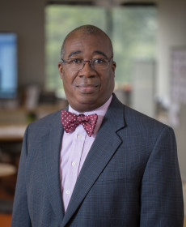
About the Speakers
Mel Thompson, Principal, Grimm and Parker Architecture, Inc.
Mel brings 25+ years of experience to our Residential & Urban Design studio, leading teams to effective solutions for our developer clients and the communities in which they work. Having delivered more than 50 residential projects, Mel has a deep understanding of the full array of products from mixed-use market-rate to affordable, workforce and senior housing, as well as low-income housing tax credits. He is an expert at master planning – managing the demands of the marketplace while ensuring community goals and regulatory constraints are accommodated. He follows-up on planning with expert design, configuring efficient and dynamic site and building plans. In addition to planning and concept development Mel is an expert at documentation and execution, working with owners and contractors to deliver on schedules and budgets.
Mel’s design leadership has guided G+P to win over 20 design awards, including recognition from the American Institute of Architects, United States Green Building Council, the National Association of Home Builders, Affordable Housing Coalition, the Housing Association of Nonprofit Developers and the Governor of Maryland’s Smart Growth Awards program. Mel is an active Board Member and Board Chair of Housing Initiative Partnership (HIP), a non-profit housing developer based in Prince George’s County.

Slide 3
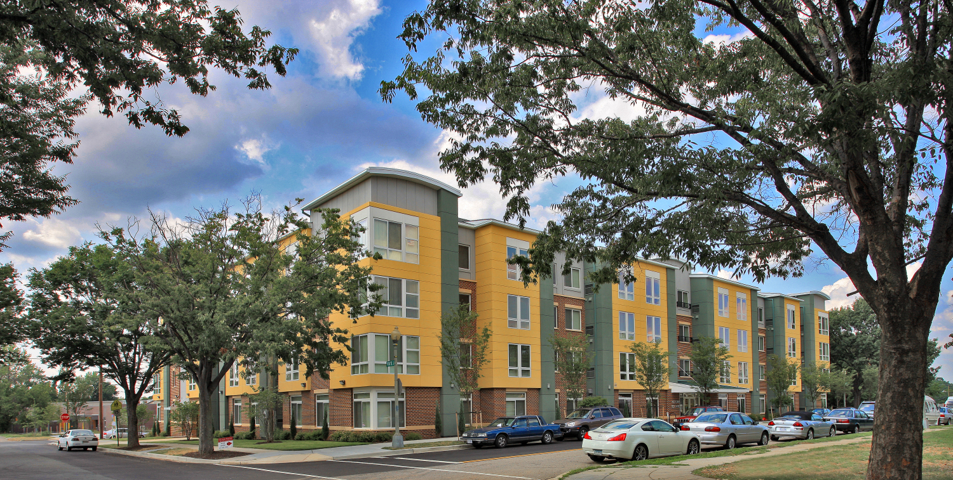
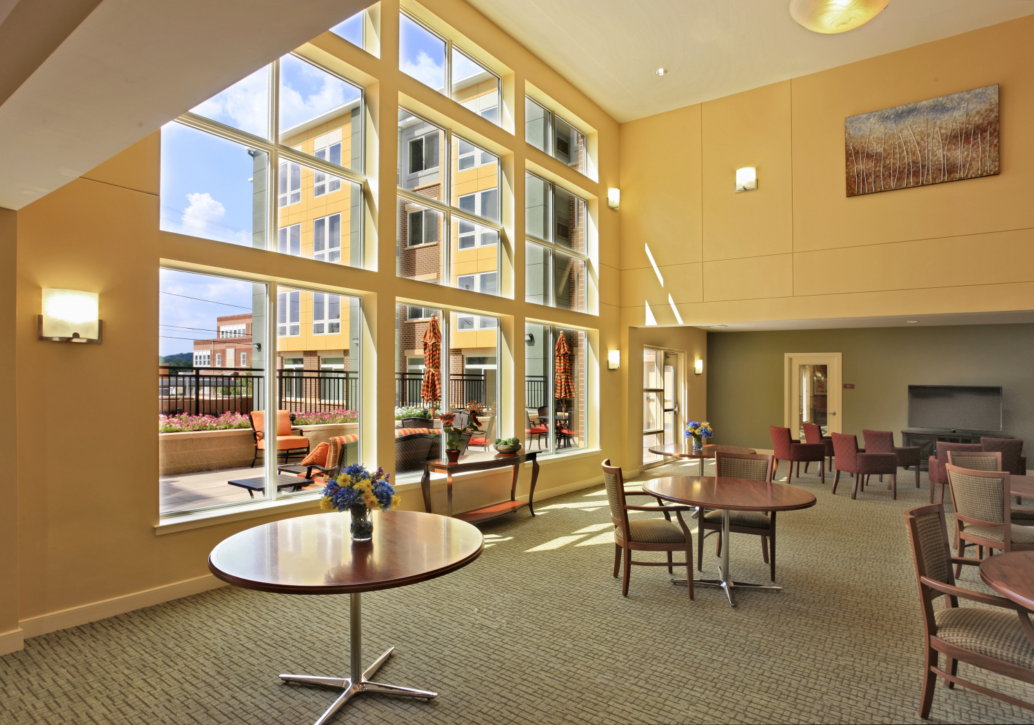
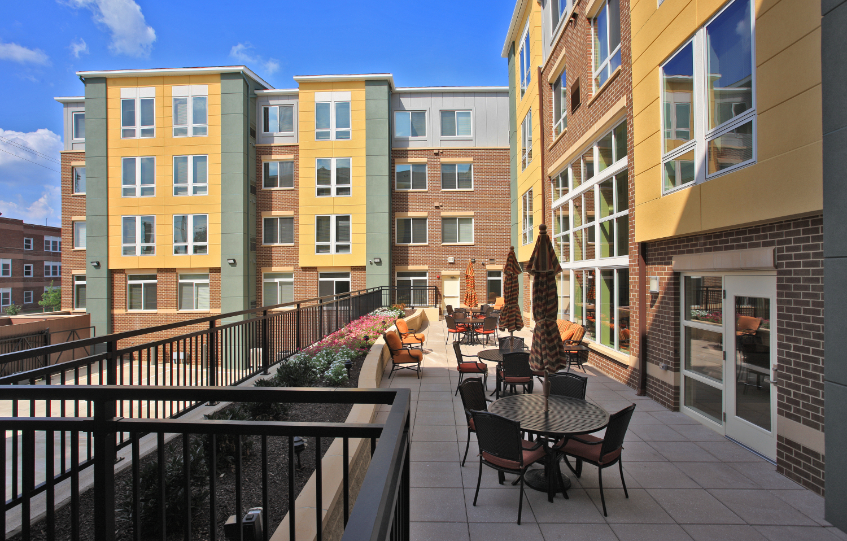
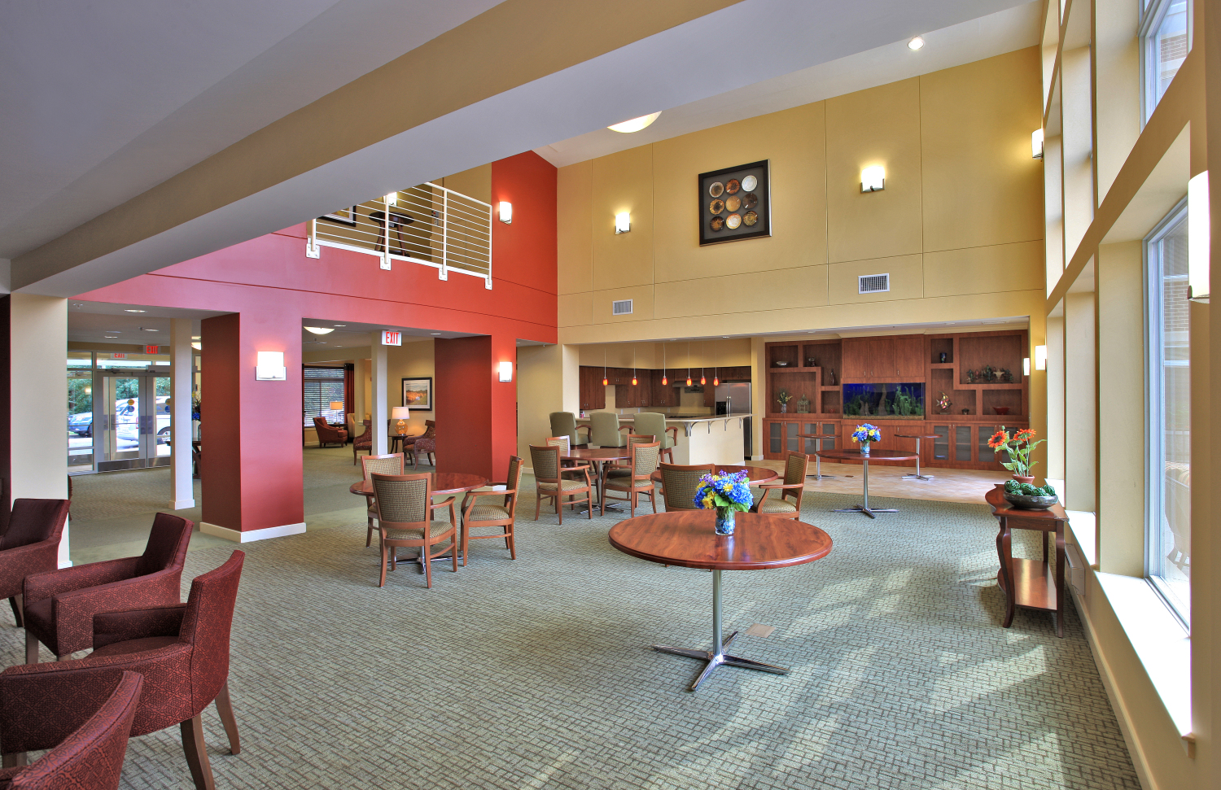
Grimm + Parker - Victory Square

Slide 4
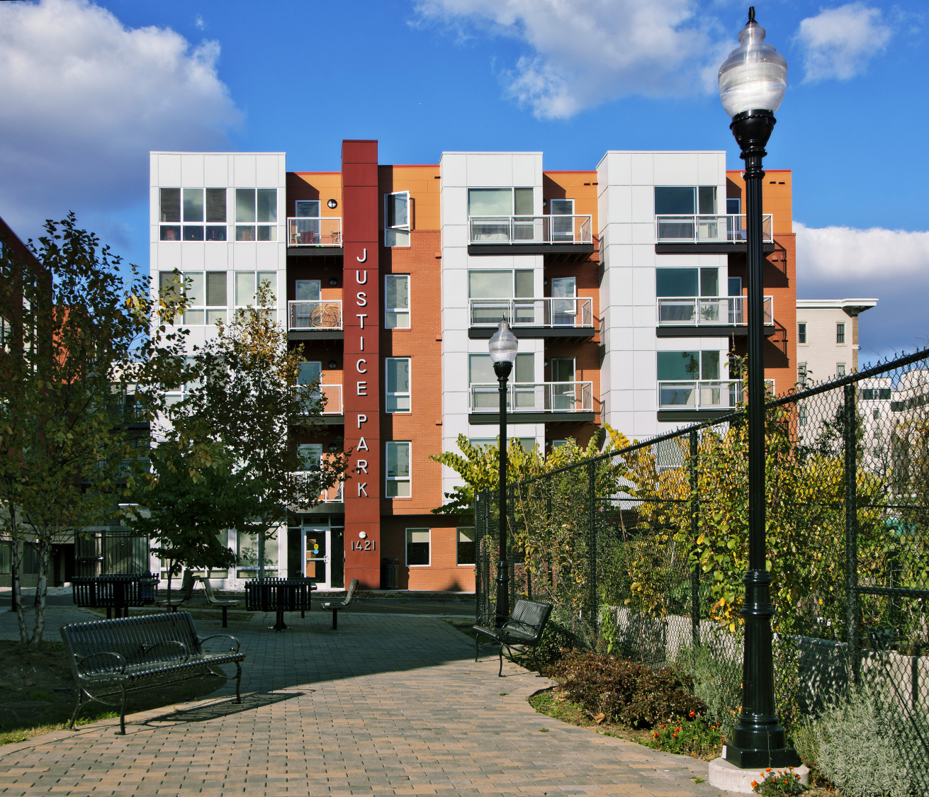
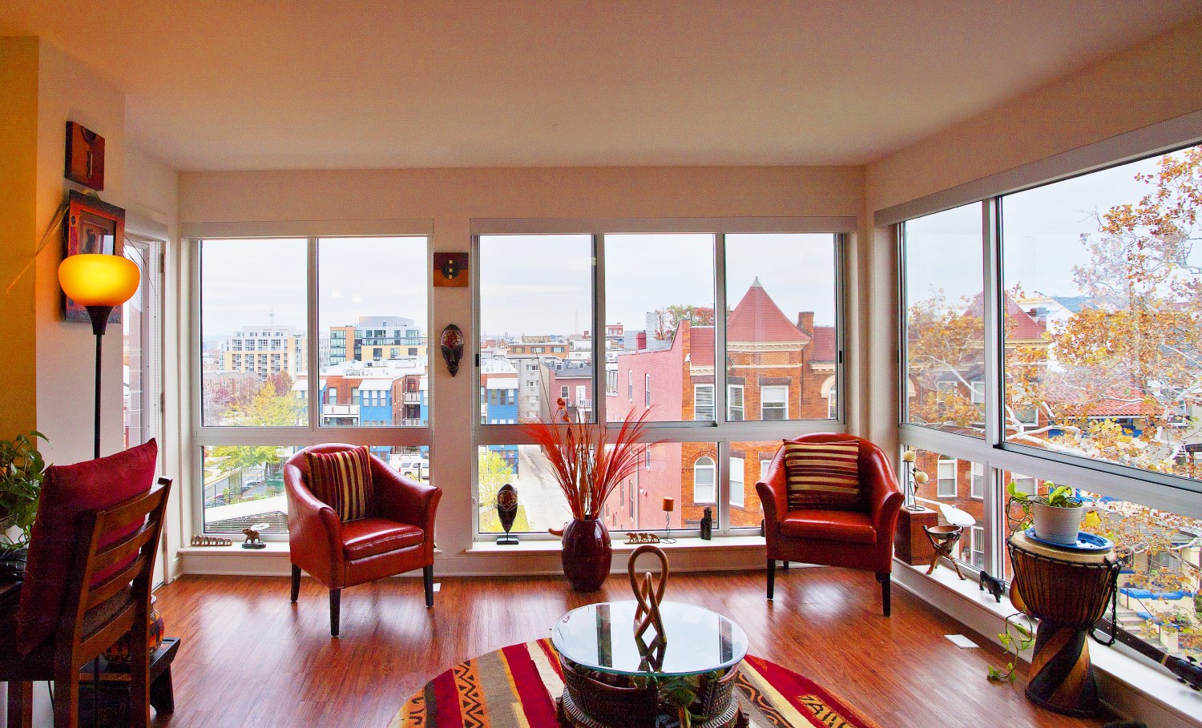
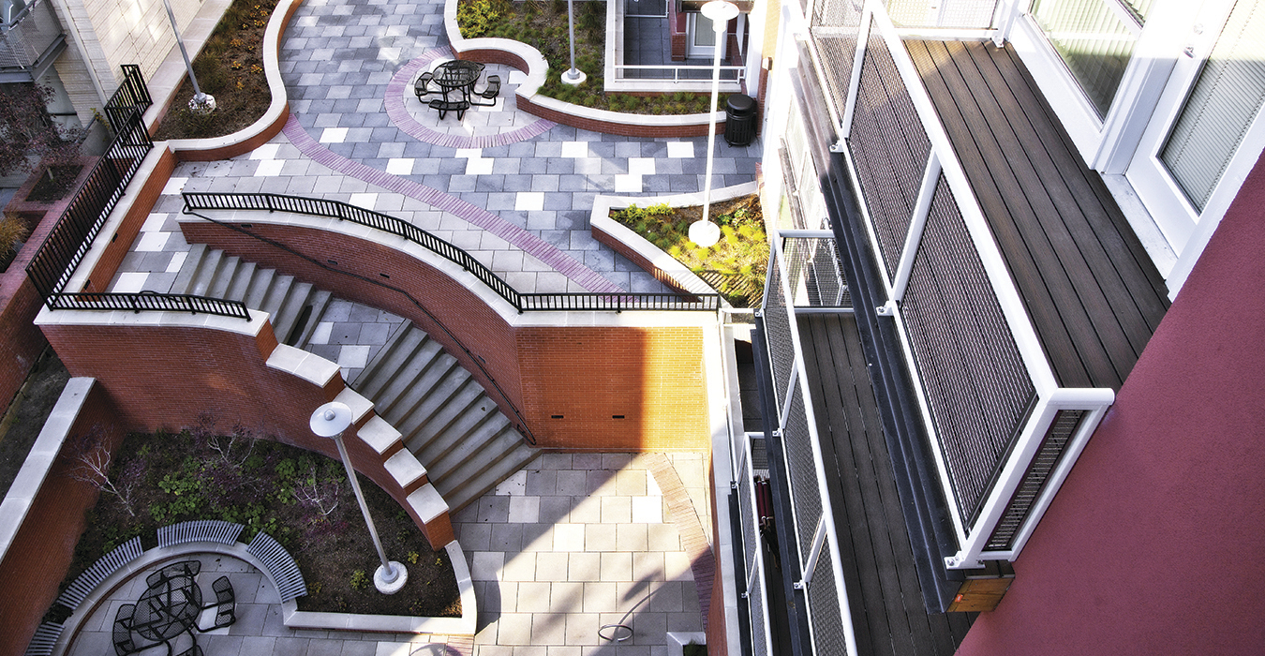
Grimm + Parker - Justice Park

Slide 5
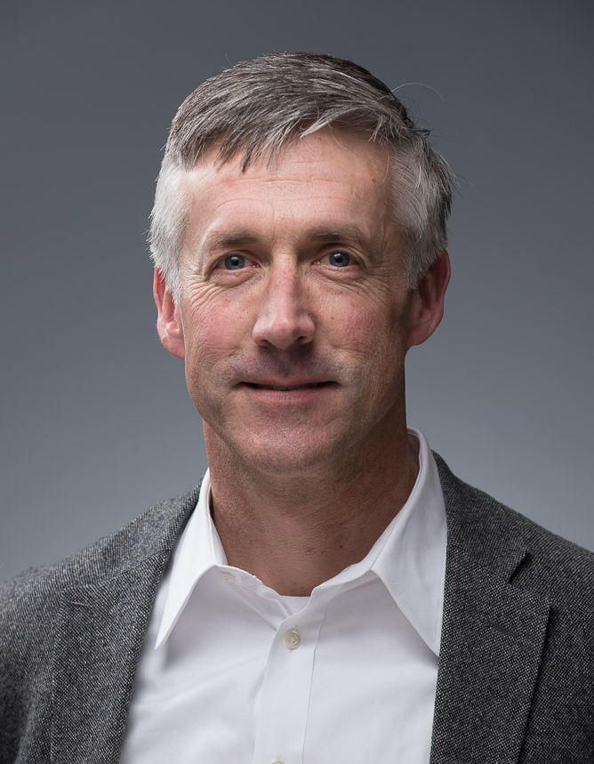
About the Speakers
Robert Hooten, President, CBP
Robert has a Bachelor of Science in Construction Management from East Carolina University. He has served as President since he founded CBP in 2014. He has led design-build teams to rehabilitate approximately 2,000 residential apartment units throughout Maryland, Washington, DC and New Jersey in the last 10 years, most were Low Income Housing Tax Credit (LIHTC) projects, and has 20 years of experience in design build general contracting.
Robert holds a Class A general contractors license in Maryland, DC, Virginia, Delaware, Pennsylvania, and New Jersey.
Robert understands how to manage and reduce risk, execute projects, be conscious of clients’ budgets and pricing contracts, and works to serve our client cash flow.

Slide 6
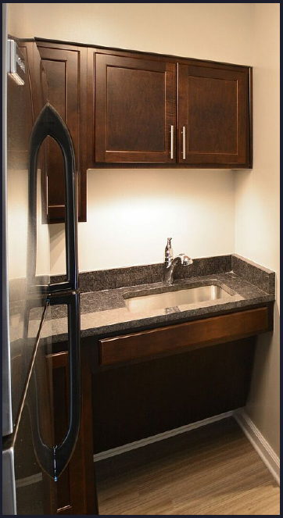
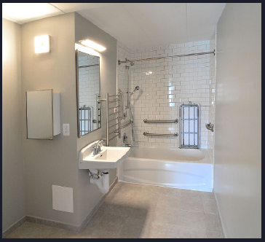
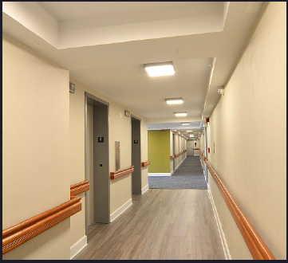
CBP - Carroll Manor

Slide 7
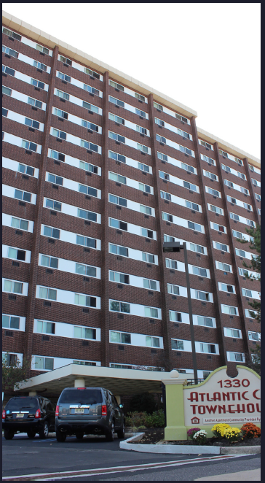
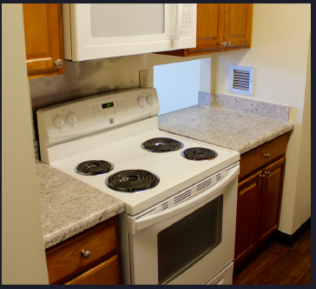
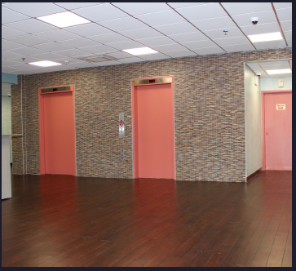
CBP - Atlantic City Townehouse

Slide 8
Agenda
Introduction of all attendees
Discussion of common challenges
Characteristics of successful projects and teams
Defining relationships
Managing and reducing risk
Defining expectations of team members
Lessons Learned
Questions and Answers

Slide 9
Introduction
Go around the room and take a few seconds to introduce yourself, your company, and briefly talk about your responsibilities.

Slide 10
Common Challenges in the DMV
Contractor price holding throughout preconstruction and construction
Material price increases
Land values
Politics and jurisdictions - friendly or not friendly to development or redevelopment

Slide 11
Characteristics of Successful Projects & Teams
Effective communication
Meeting weekly during pre-construction
Constructability/staying in touch regarding budget, scope, and all changes
Defining expectations
Articulate end goals for each team member (developer, architect, contractor)
Meeting at least bi-weekly during construction
Leadership
Common goals
Teamwork
Tracking data and info for future success
Making and documenting decisions along the way
Who is responsible for documenting? How is everything documented? How is it distributed to everyone?

Slide 12
Defining Relationships
Looking at the project from all directions
Responsibilities and communication

Slide 13
Managing and Reducing Risk
Risk
Cash flow
Tenant relocation
Unit acceptance
Delivery dates
Different types of projects each bring their own challenges
New construction
Renovation
Tenant in place renovations
Ongoing maintenance costs
Clarity brings with it better numbers – costs increase with lack of clarity

Slide 14
Defining Expectations of the Team Members
Development schedules
Pre-Construction and post construction
Clarity on tax credits, allowances, clarifications, and exclusions while project still in pre-preconstruction phase
Setting up key milestones throughout the projects
Managing the time and money of all involved
CA Process flow
Speaking openly about issues and resolution of issues
Who is the decision maker for each team?
Leaders take responsibility, delegate, and resolve

Slide 15
Lessons Learned
Communication is key
Defining the pre-construction/development, construction and post construction schedules
Defining the responsibility for and response times of communication between each party
Make commitments and follow through with those commitments
Owners giving architects enough money to properly respond during pre-construction and CA work
Prioritize issues

Slide 16
Questions and Answers

