Slide 1
Innova Services Corporation Owner’s Representation
Innova has overseen the design and construction of affordable housing and mixed-use developments valued at over $2.0 billion, with new projects totaling more than $200 million annually throughout the eastern United States.

Slide 2
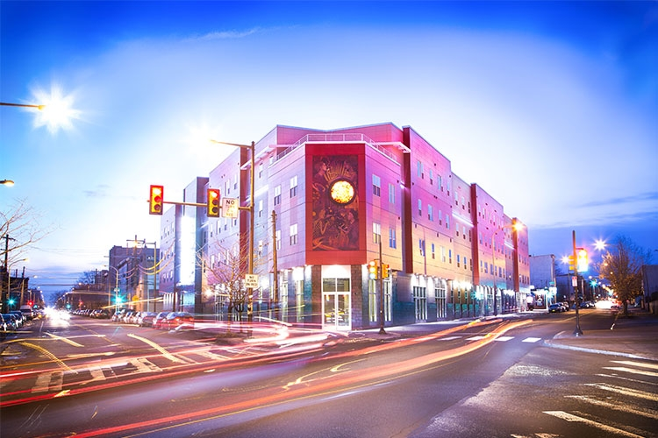

Slide 3
Innova Services Corporation Building Performance
Innova provides energy rating and verification services including certification of Energy Star™, Enterprise Green Communities, National Green Building Standard and Passive House compliance.

Slide 4
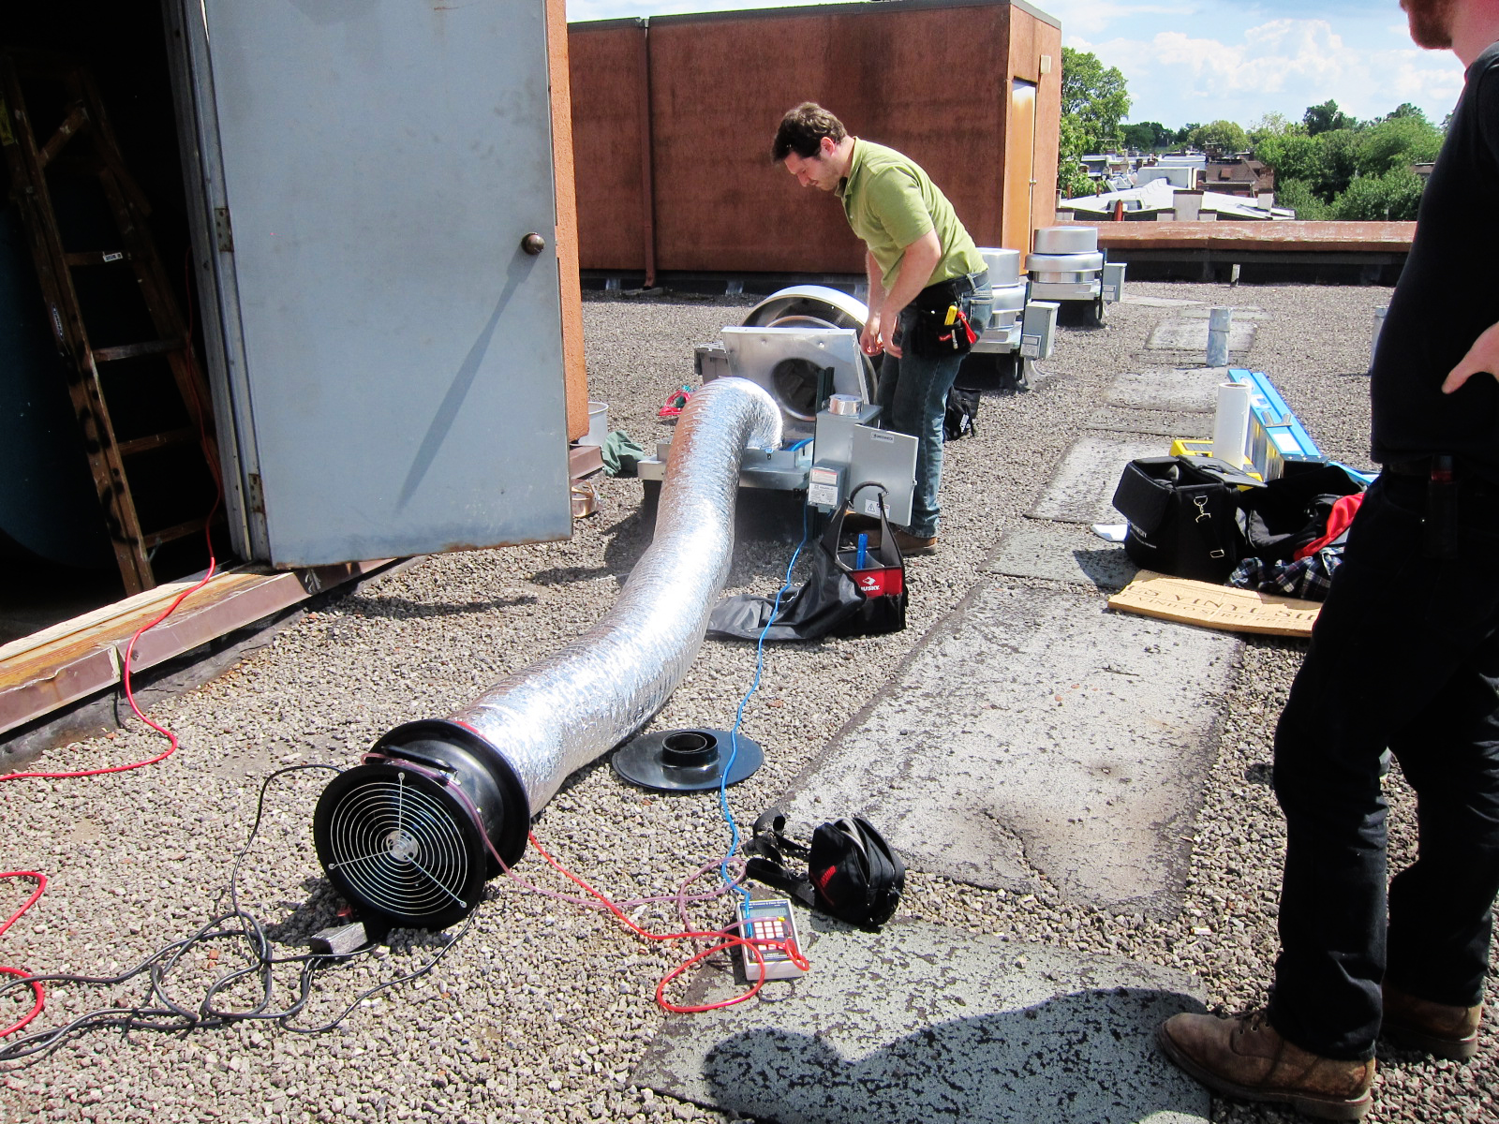

Slide 5
Innova Services Corporation General Contracting
Innova's building maintenance roots provide us with unique insights about building efficiency and component durability, enabling us to develop strategic capital improvement plans and act as effective general contractors for occupied rehabilitation projects.

Slide 6
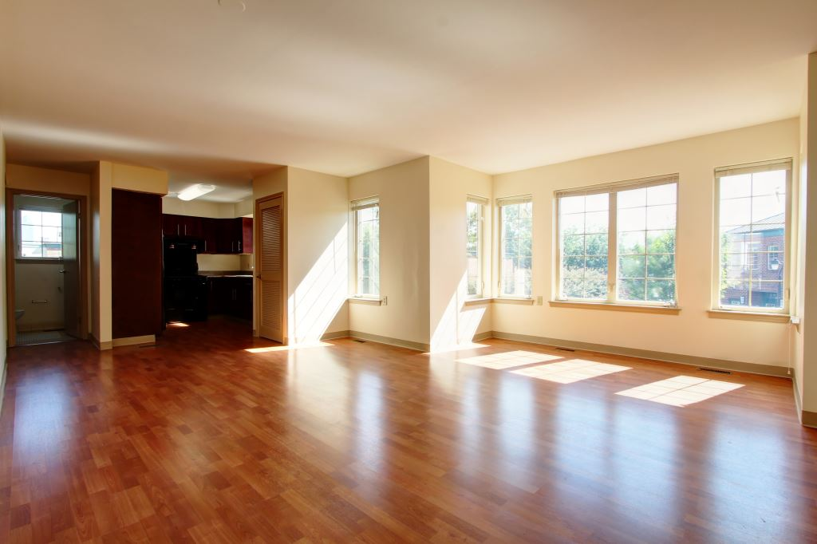

Slide 7
Innova Services Corporation Neighborhood Redevelopment
Innova's development arm, Innova Redevelopment, LLC, fosters neighborhood stabilization of transitional neighborhoods that border high value areas through the redevelopment of existing housing; replacing sources of blight with quality housing that is affordable over the long term.

Slide 8
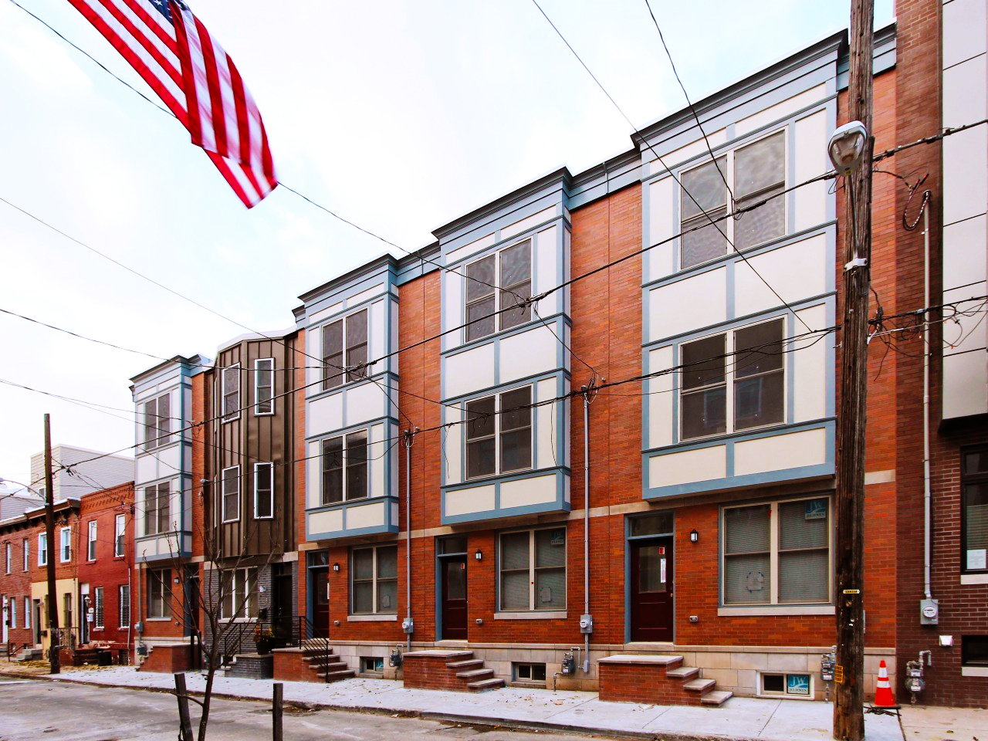

Slide 9
Cost Containment Strategies Contractor Selection
When to engage a Contractor?
Early:
Engage contractor at schematic or even programming phase to inform design decisions and provide cost feedback.
Late:
Conduct a hard bid process, rely ondprofessionals to produce an affordable design, then go to the market to get most competitive price.

Slide 10
Cost Containment Strategies Contractor Selection
Late (Hard Bid) Selection:
Considerations:
Plans must be 100% complete. Ambiguity exposes Developer to change orders and/or inflated bid amounts.
Potential bidders MUST be vetted thoroughly before allowing them to bid. Ensure they have experience in your product type, call previous clients, check with funding agencies (recommend RFQ process prior to bid).
Demand high levels of detail on bid form: Quantities, unit costs, material and labor breakdowns so that bids can be descoped thoroughly. All bidders must use same bid form and provide same information.
Generally requires an experienced construction manager on the Developer’s side Must have expertise to evaluate drawings, provide some level of cost input during design, develop RFQ/Bid requirements documentation and most importantly, thoroughly descope bids.

Slide 11
Cost Containment Strategies Contractor Selection
Late (Hard Bid) Selection:
Pros
Competition between contractors generally produces lower initial cost.
Some funding sources require bid processes, particularly when exceeding HUD cost caps ( HUD 221 D3).
Perception of fairness; Stigma of “no-bid” contracts on jobs using public funding.

Slide 12
Cost Containment Strategies Contractor Selection
Late (Hard Bid) Selection:
Cons
“Biggest liar wins”: Often, the contractor that left out the most, has the lowest bid. Even the most competent construction manager can’t find all the holes in a bid for a complex project.
No certainty of project costs until the end of the design process, often right before projected closing date. Overages require redesign and impact project schedule/funding timelines.
Contractors who cut their bid to the bone to win the project will more often than not, be motivated to make up the margin they gave away in the bid during construction. This tends to result in a greater number of change orders during construction.
Relationship with contractor during construction tends to be more adversarial than team oriented. A bid process doesn’t incentivize problem solving on the part of the contractor.

Slide 13
Cost Containment Strategies Contractor Selection
Early (Negotiatied) Selection:
Considerations:
Get Contractor on board as soon as possible. Cost feedback is useful from day one. I have clients that engage contractors at the application phase to verify initial budgets (this does not mean that you have to use them later, but contractors may be willing to do this to get their foot in the door if the project ends up getting funded).
Potential Contractor partners MUST be vetted thoroughly before engaging them in the process. Ensure they have experience in your product type and the negotiated process, call previous clients, check with funding agencies (recommend RFQ process to select).
Demand costs, and change order amounts on recently constructed projects of the same type and where contractor was part of design process (in RFQ).
Make clear to the selected contractor that they do not automatically get the job. If contractor is not able to get the job into your budget, you need to be able to go out and find a different contractor who can.
Also requires a competent construction manager on the

Slide 14
Cost Containment Strategies Contractor Selection
Early(negotiated) Selection:
Pros
REAL cost input at each stage of design process. Ability to receive “spot” estimates to determine cost impact of design decisions.
Input from contractor on constructability, material costs and schedule considerations throughout process.
Team dynamic ALL team members working toward same goal. Incentivizes problem solving.
Having contractor at the table throughout mitigates exposure to change orders. Contractor able to clarify details, identify missing info prior to construction.

Slide 15
Cost Containment Strategies Contractor Selection
Early (negotiated) Selection:
Cons
Potentially results in a higher initial construction cost (Contractor knows too much about the project).
Perception of fairness; Stigma of “no-bid” contracts on jobs using public funding.
Buyer’s remorse: Could you have gotten a better price? Could you have saved the design features you wanted, but got left on the VE cutting room floor if you bid it out?

Slide 16
Cost Containment Strategies Contractor Selection
Conclusion:
Generally, early selection of the contractor results in a smoother design and construction process, less change orders and more certainty about the final cost of the project. Smaller, simpler projects probably benefit more from a bid process than larger, more complex ones.

