Slide 1
Who Gets What When the Partnership is Liquidated
Presented By:
Terence Kimm
Terry.Kimm@CohnReznick.com
301-657-7766

Slide 2
Today’s Agenda
Partnership Capital Accounts
Sample Partnership Agreement
Sample Back End Calculations
4% deal
9% deal
Concluding Comments

Slide 3
Partnership Capital Accounts
All Partners in a Partnership Have a Capital Account
Safe Harbor Capital Account Maintenance Rules under IRC 704(b)
All Capital Accounts Start at Zero
Increased by Capital Contributions
Increased by Income & Gain Allocations
Decreased by Loss & Deduction Allocations
Decreased by Distributions
Upon Liquidation, all Capital Accounts Return to Zero

Slide 4
Sample Partnership Agreement
Partnership Profit, Loss & Cash allocations controlled by Partnership Agreement
Section 5 – Allocations of Profits from Capital Transactions
Section 6 – Distributions and Applications of Cash Flow from Capital Transactions
Section 10 – Dissolution and Termination of the Partnership

Slide 5
Section 5 – Allocations of Profits from Capital Transactions
Profits from a Capital Transaction shall be allocated to the Partners in the following order of priority:
A) To the LP to eliminate any negative capital account.
B) To the GP to eliminate any negative capital account.
C) The balance to the Partners in accordance with their sharing ratio of Section 6G.

Slide 6
Section 6 – Distributions and Applications of Cash Flow from Capital Transactions
Sale or Refinancing Proceeds shall be applied in the following order of priority:
A) To the payment of all expenses of such sale or refinancing.
B) To the payment of all debts and obligations of the partnership other than amounts owed to Partners.
C) To establish any Reserves reasonably required by the GP.
D) To repay any LP Loans.
E) To repay any GP Loans.
F) To repay any balance remaining on the Development Fee.
G) The balance shall be distributed 20% to the LP and 80% to the GP.

Slide 7
Section 10 – Dissolution and Termination of the Partnership
10.1 Events which cause a Dissolution of the Partnership shall include:
A) Election made by the GP with the consent of the LP
B) Withdrawal of GP
C) Sale or other disposition of all or substantially all of the assets of the Partnership.
10.2 Priority on Liquidation – To extent proceeds are sufficient, they shall be applied in the following order:
A) In accordance with Section 6A through 6F
B) The balance shall be distributed in accordance with positive Capital Accounts.

Slide 8
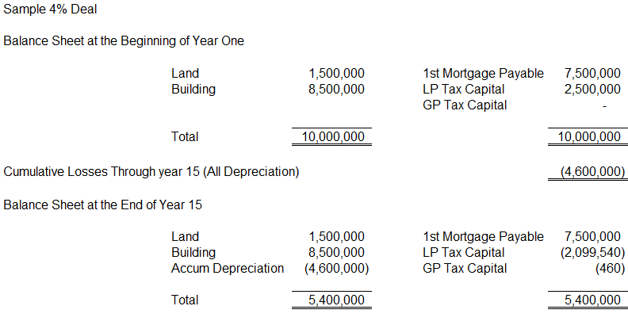
Sample 4% Deal Liquidation Calculation

Slide 9
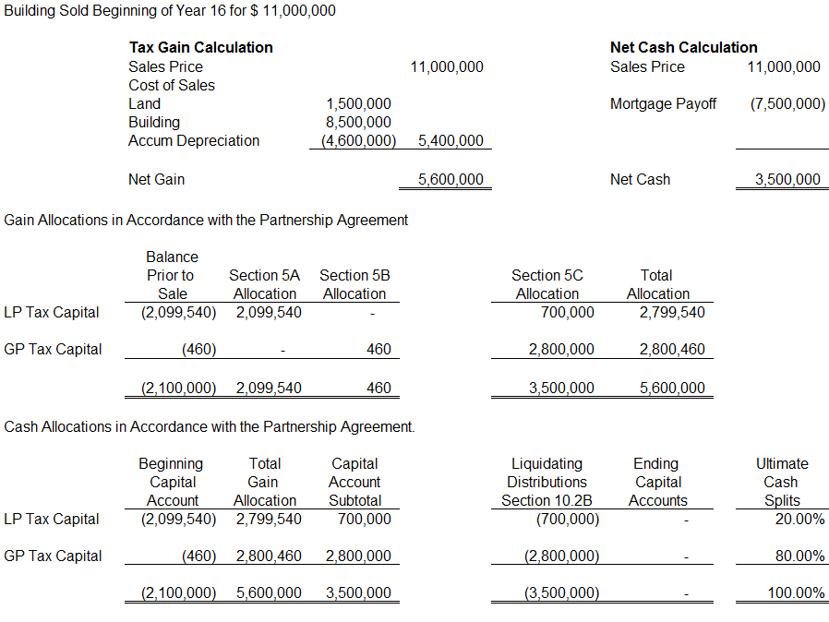

Slide 10
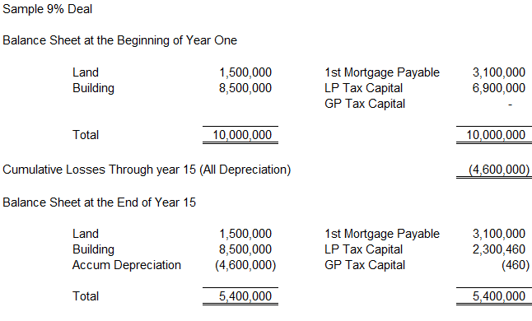
Sample 9% Deal Liquidation Calculation

Slide 11
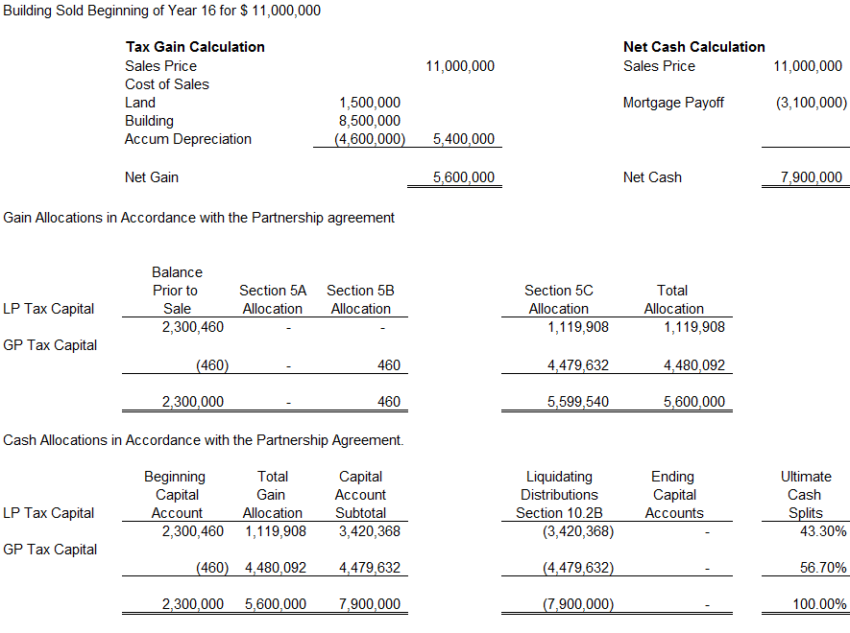

Slide 12
What If the Ultimate Allocations of Cash Aren’t What You Expected?
For Existing Deals Approaching Year 15:
Stay out of the Liquidation Section of the Partnership Agreement
Refinance instead of Selling (Note the LP must consent to refinancing)
Negotiate the purchase of the LP interest
Where applicable, use not-for-profit right of first refusal.
Manage the Tax Capital accounts – Generate more tax losses

Slide 13
What To Do for New Deals:
Negotiate Special Gross Income Allocation Provisions
Negotiate Right to Purchase LP Interests
Forced Sale Rights
Do not allow them
If used, agree to how cash will be distributed up front
Factor in Year 15 Distributions in Credit Pricing

