Slide 1
HAND AHP Competitive Presentation
January 22, 2015
1

Slide 2
Our Objectives Today
Overview of FHLBank System
Value and Benefit in Using FHLBank Products
How To Apply for AHP Competitive Funding
Dispelling the Myths About AHP Competitive
Q & A

Slide 3
FHLBank System Overview
FHLBank Atlanta is one of 12 district banks in the Federal Home Loan Bank System
The FHLBanks are government-sponsored enterprises, or “GSEs,” created by the Federal Home Loan Bank Act of 1932
FHLBank Atlanta’s territory comprises Alabama, Florida, Georgia, Maryland, North Carolina, South Carolina, Virginia and the District of Columbia

Slide 4
The Twelve FHLBanks
4

Slide 5
FHLBank System Overview
The Bank is a cooperative, owned by its shareholders
Shareholders purchase stock in the Bank, and they receive dividends on their stock investments
Shareholders include commercial banks, savings and loan institutions, credit unions, community development financial institutions (CDFIs), and insurance companies

Slide 6
Unique Offering to Shareholder and Community
Like every “dividend,” predicated upon earnings
“Equity-like” capital for real estate transactions, in the form of an AHP subsidy
Direct and indirect benefits to shareholders, developers, homebuyers, tenants, and the community
FHLBank
Products
10 percent
Earnings
Community
Dividend
=

Slide 7
Scale and Impact
$672.9 Million
competitive funds awarded to create over 105,000 rental and homeownership opportunities for moderate-, low- and very low-income households since 1990.
AHP Competitive Leverage Ratio – 1:14
AHP
Competitive
Program
AHP
Set-aside
Program
$144 Million
funded through AHP Set-aside products and supporting more than 20,000 units since 1997.
AHP Set-aside Purchase Leverage Ratio – 1:20
Community
Investment
Program
$6.9 Billion
low-cost CICA advances supporting community economic initiatives and affordable housing development.
Economic
Development
Program
*As of 6/30/2014
Notes:
Since 1990 we have funded over $648M in our competitive program. This has provided over 102,600 housing opportunities for moderate, low and very low income households.
For every dollar we contribute there are on average $13 from other sources.
Since 1997 we have funded over $126M in our Set-aside program. This has provided an additional 18,700 housing opportunities for moderate, low and very low income households.
This is a total of over 121,000 units.
We have additional done over $6.9B of Community Investment advances.

Slide 8
Connecting the Dots
Community
Funds are invested in community- based transactions generating successful lending opportunities
Growing communities create demand for additional financing
Direct Benefit
Viable lending,
new customers,
reduced loan risk
Shareholder
Indirect Benefit
New and rehabbed housing,
growing local tax base,
job creation
FHLBank Atlanta provides “equity-like” funding enabling shareholders to make transactions viable and attract new customers
Shareholder originations
create demand for advances
FHLBank Atlanta

Slide 9
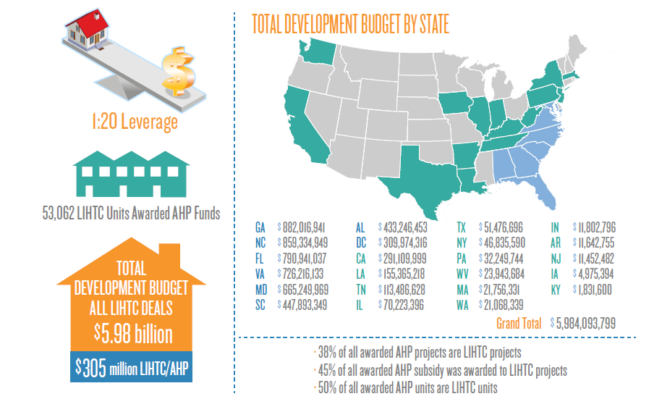
FHLBank Atlanta LIHTC AHP Cumulative Scale and Impact
(1990-2014)

Slide 10
Scale and Impact of AHP Competitive Comparison By Project Type - Awarded 1990-2014
Key Takeaway:
Since AHP inception, 38% of AHP Competitive projects awarded are Rental LIHTC
Rental LIHTC
projects have
a significantly
higher leverage
ratio than other
project types
Project Type | # Projects | AHP | Dev. Costs | Leverage
Rental - LIHTC | 822 | $302 Mil | $5.9 Bil | 1:20
Ownership | 801 | $177 Mil | $1.7 Bil | 1:10
Rental Non-LIHTC | 547 | $194 Mil | $1.4 Bil | 1:7

Slide 11
Scale and Impact of AHP Competitive Number of Units Rental LIHTC vs. Rental Non-LIHTC, 1990-2014
Key Takeaways:
Since AHP inception, 65% of Atlanta’s AHP Competitive rental units are LIHTC
Atlanta Bank has provided AHP awards for over 52K LIHTC units
Project Type | # Units | AHP | Dev. Costs | Leverage
Rental - LIHTC | 52,538 | $302 Mil | $5.9 Bil | 1:20
Rental Non-LIHTC | 28,785 | $194 Mil | $1.4 Bil | 1:7

Slide 12
Value and Benefit in Using AHP Products

Slide 13
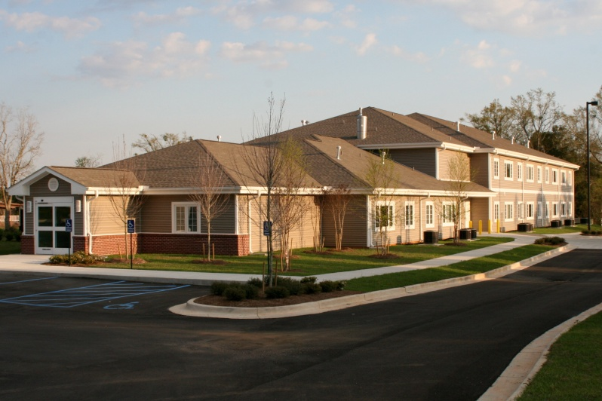
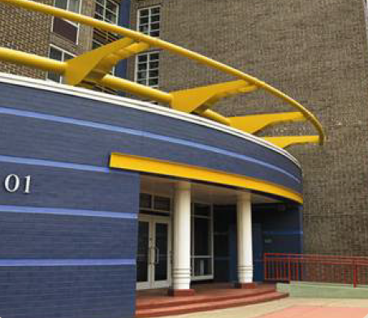
AHP Competitive Eligible Projects
Rental (Income Producing)
Types
Low-Income Housing Tax Credit (LIHTC)
Non-LIHTC multi-family
Mixed-Use
Use of Funds
Acquisition
New Construction and/ or Rehabilitation
Development Soft Costs
Supportive Housing (Non Income Producing)
Social Service Residential Facilities
Ownership Transactions
Use of Funds
Down Payment Assistance
Owner Occupied Rehabilitation
Accessible Space, Inc. Anderson-Fischer Apartments
$95,000 AHP Subsidy
20 Rental Units for Supportive Housing
Edgewood Terrace
Washington, DC
AHP : $1,200,000 (subsidy and loan)
292 Supportive Housing Units
Notes:
Very low income means at or below 50% of area median income

Slide 14
Extend Credit and Reduce Loan Risk
Multi-family Purchase and Rehabilitation
Housing for Homeless Veterans
Washington, D.C. 43 units
Permanent Sources and Uses | Total Costs | AHP | Shareholder | Other Sources
Acquisition | $850,000 | $450,000 |  | $400,000
Construction | $500,000 | $50,000 | $450,000
Soft Costs
Other Costs | $83,000 |  | $83,000
Total Development Budget | $1,433,000 | $500,000 | $533,000 | $400,000
Total Debt – First Mortgage | $533,000
Member Loan-to-value (LTV/Cost) | 37.2%
AHP Competitive | $500,000
Total Debt if AHP converted to Debt | $1,033,000
Member LTV/Cost if AHP converted to Debt | 72.1%
DER | 1.15
DER if AHP converted to Debt (7% for 15 years) | 0.67
“AHP has the ability to fill funding gaps.” – FHLBank Atlanta Shareholder

Slide 15
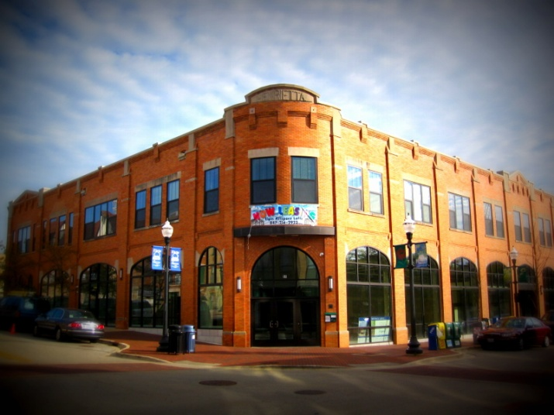
Extend Credit and Reduce Loan Risk
Acquisition / Rehabilitation
Very Low Income Affordable Housing
Newport News City, VA 80 units
Permanent Sources and Uses | Total Costs | AHP | Member | Other Sources
Acquisition | $1,350,000 |  | $950,000 | $400,000
Construction | $6,579.724 | $714,000 | $950,000 | $4,915,724
Soft Costs | $1,380,734 |  |  | $1,380,734
Other Costs | $1,914,619 |  |  | $1,914,619
Total Development Budget | $11,225,077 | $714,000 | $1,900,000 | $8,611,077
Total Member Debt – First Mortgage | $1,900,000
Member Loan-to-value (LTV)/cost | 16.9%
AHP Competitive | $714,000
Total Member Debt if AHP converted to Debt | $2,614,000
Member LTV/cost if AHP converted to Debt | 23.3%
DER | 1.36
DER if AHP converted to debt (7.5% for 15 years) | .91
Notes:
11A04002 Phelps Road Place Apartments

Slide 16
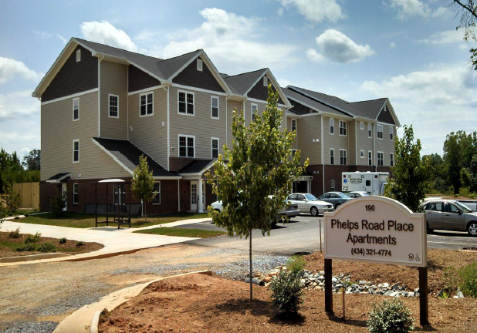
Extend Credit and Reduce Loan Risk
Rental, New Construction
Very Low Income Affordable Housing for Disabled Residents and their Families
22 units
Construction Sources and Uses | Total Costs | AHP | Shareholder | Other Sources
Acquisition | $135,000 | $135,000 |  | $0
Construction | $2,930,665 |  | $2,000,000 | $930,665
Soft Costs | $482,462 | $19,000 |  | $463,462
Other Costs | $667,781 |  |  | $667,781
Total Construction Budget | $4,215,908 | $154,000 | $2,000,000 | $2,061,908
Permanent Sources and Uses
Total Shareholder Debt – First Mortgage | $0
Member Loan-to-value (LTV)/cost | --
AHP Competitive | $154,000
Total Member Debt if AHP converted to Debt | $154,000
Member LTV/cost if AHP converted to Debt | 3.7%
DER | 1.34
DER if AHP converted to debt (7.5% for 15 years) | .25
Notes:
11A04002 Phelps Road Place Apartments

Slide 17
Why Would a Member Bank Want to Participate?
Business Value
Enable members’ extension of credit
Enable members’ lending on difficult to finance transaction
Could enhance local positive branding of member
Value proposition for members to attract new relationships with developers
Offer to members as a direct value proposition to establish public unit relationships
Local governments
Use to connect with non-profit and for-profit developers doing business in members’ markets
Compliance Value
Reduce member’s loan risk in transaction
Enable members’ extension of credit
CRA-eligible Lending Opportunity
Member sponsored the AHP Competitive application for the direct subsidy
CRA-eligible Service Opportunity
Tenants in project are all at 80% or below of area median income
Project positioned as a CRA-eligible activity
Notes:
Here is an example of how AHP funds can be used to extend credit and reduce loan risk to members.
This is a 43-unit multifamily rental project in Washington, DC, targeted o housing for homeless veterans.
The total development budget for this project was $1,433,000, including $533,000 of member first mortgage debt and $500,000 of AHP funds.
Using AHP funds, the LTV on the first mortgage was 38.2% with a 1.15 debt coverage ratio. If the sponsor would have had to borrower market-rate debt in lieu of AHP funds, the LTV would have been 72.1% with a DER at .67.

Slide 18
How To Apply for AHP Competitive Funding

Slide 19
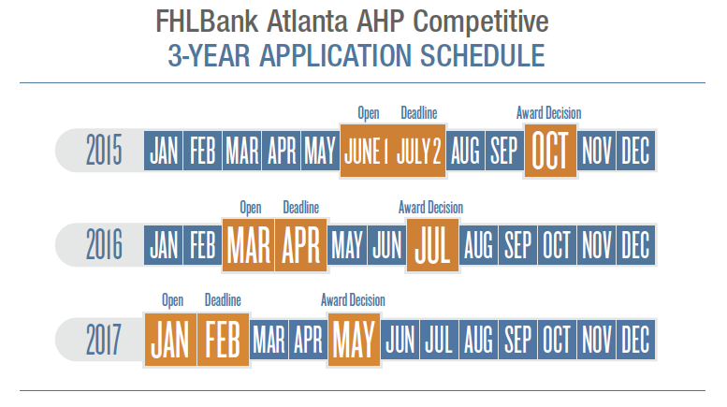
How to Apply for AHP Competitive Funding
All applications include a sponsor and a member
Members are the financial institutions that are part of the Federal Home Loan Bank of Atlanta. Virginia Community Capital would be the member.
Sponsors are housing developers, public entities, contractors, community builders, and other organizations engaged in housing construction, rehabilitation, and development of affordable rental or owner-occupied housing.

Slide 20
How to Apply for AHP Competitive Funding
Getting Started
All applications include a FHLBank Atlanta Member and a Sponsor
Members are the financial institutions that are part of the Federal Home
Loan Bank of Atlanta
Member list is on the FHLBank Atlanta website
Call if you would like assistance on reaching the right person
Sponsors are housing developers, public entities, contractors, community
builders, and other organizations engaged in housing construction,
rehabilitation, and development of affordable rental or owner-occupied
housing
Sponsors drive the application process; members review and approve
applications

Slide 21
How to Apply for AHP Competitive Funding
Detailed webinars are offered to review the actual application content
Application is submitted through AHPOnline, accessed on the home
page of the FHLBank Atlanta website
Sponsor submits application to member for review and approval
FHLBank Atlanta member approves application and submits to FHLBank
Atlanta the supporting documents via electronic media by sponsor

Slide 22
How to Apply for AHP Competitive Funding
Up to $500,000 per project
Threshold Criteria
Site control
20% of permanent funding committed
Supporting documentation
Sponsor is qualified and able

Slide 23
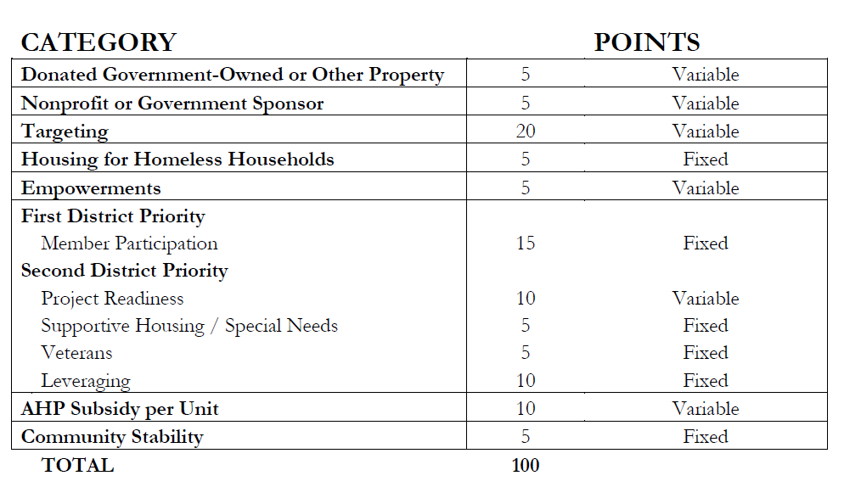
How to Apply for AHP Competitive Funding
Scoring

Slide 24
How to Apply for AHP Competitive Funding
Underwriting
Budget Guideline Examples
Costs must be reasonable
Developer fee
Reserves
Soft costs
Operating Budget Guidelines (Rental Projects)
DER
Cash Flow
Income and expense trending
Management Fee
Market Feasibility

Slide 25
Intake, Processing, Underwriting and Approval
AHP Competitive
Intake
AHP
Online
Application (input data & docs):
Threshold doc review
Scoring initiated
Underwriting
Assigned
to
Analyst
Process data & documents:
Additional documentation
Clarification
Validation
Underwriting & Analysis:
Financial feasibility
Development feasibility
Cash flow analysis
Quality Control:
UW Consistency
Market viability
Fraud mitigation
Top 150% scores relative
to available funding
July 2nd – July 23rd
Approval
Affordable
Housing
Advisory
Council
Consultation
CIS Director
Recommendation
CIS Committee Recommendation
Board of Directors
Approval
Oct. 13th
Oct. 27th- 28th
Oct. 28th -29th
CIS Committee
AHAC
Board Approval

Slide 26
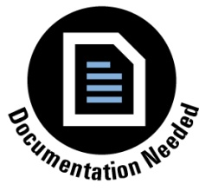
Project Milestones
Development
Oct 2015: Award Notifications
6 Months (Apr 2016):
Zoning
12 Months (Oct 2016):
All funding sources must be committed
18 Months (Apr 2017):
Start construction and AHP funded
3 years (Oct 2018):
Report Complete
Compliance
Affordability/Retention Period
5 Year Retention – Ownership
15 Year Retention - Rental
Initial Monitoring Review (IMR)
Within 2 years of reporting complete
Long Term Monitoring (LTM)
Rental (excluding LIHTC) only
Every 2 – 6 years

Slide 27
What’s New for AHP Competitive?

Slide 28
What’s New for AHP Competitive?
FHLBank Atlanta 2015 AHP Competitive Round Opens June 1, 2015.
To help you be even more competitive, take note of this year’s results and a few changes in store for the 2015 Affordable Housing Program (AHP) offering.
The 2015 round will open June 1, 2015, and will close for new applications on July 2, 2015.
 | 2014 | 2015
Income Calculation Methodology | Income calculated based on the 80% county area median income data published by HUD | To help developers reach more customers: Income calculated based on the greater of four methodologies, based on data published by HUD 100% county area median income data basis 80% county area median income data basis 50% county area median income data basis 80% state median family income basis
Replacement Reserves | $200 - $350 per unit per year Projects without lender required or managed reserves, reserves are not allowed in the proforma | To help developers create long term sustainable units: $300 - $450 per unit per year, depending upon type of construction, location, building type, and other relevant factors Provision is removed

Slide 29
What’s New for AHP Competitive?
 | 2014 | 2015
Consultant Fees | Developer fees (including fees paid to consultants for services normally provided by a developer) are not allowed for rehabilitation projects with no transfer of ownership | To assist nonprofit sponsors in accessing professional assistance: 5% developer fee maximum for rental projects with no transfer of ownership where the project is 100% owned by the non-profit developer
Community Stability | 5 points (variable): Up to 2 points for the redevelopment of vacant or abandoned buildings 2 points for projects that are located in a neighborhood that is part of a documented neighborhood stabilization plan 1 point for projects that do not displace existing low to moderate income residents | To provide better clarification: 5 points (fixed) for projects that include any of the following: Redevelopment of vacant or abandoned buildings Projects that are located in neighborhoods that are part of a neighborhood stabilization plan approved by a unit of federal, state or local government Projects that do not displace existing low or moderate income households

Slide 30
What’s New for AHP Competitive?
 | 2014 | 2015
Readiness | 0 Points for 9% LIHTC projects that have submitted an application for tax credits and the application is pending decision 10 points for 4% LIHTC / bond projects that have tax credits awarded by state allocation agency, bond inducement resolution, or equivalent | To create additional point opportunities: 5 points for 9% LIHTC project in which a tax credit application that meets the threshold requirements has been submitted to the state allocating agency and the application is pending decision 5 points for 4% LIHTC / bond projects that have tax credits awarded by state allocation agency, bond inducement resolution, or equivalent
Total Soft Costs | All rental projects: 28% maximum of total development costs | To provide better clarity to bond transactions: 9% LIHTC: Soft costs 28% maximum of total project costs 4% LIHTC with bonds: Soft costs 35% maximum of total project costs Non-LIHTC projects: Soft costs 22% of total project costs

Slide 31
What’s New for AHP Competitive?
 | 2014 | 2015
Deferred Developer Fee/Sponsor Equity |  | To prevent fraud and abuse: New provisions: Deferred developer fee in place at the time the construction financing closes becomes the amount of deferred developer fee that must remain in the project If the development budget has deferred developer fee at the time construction financing closes, new or additional sources to the project must first reduce AHP before reducing the deferred developer fee source

Slide 32
Dispelling the Myths About AHP Competitive

Slide 33
Dispelling the Myths About AHP Competitive
Myth
Reality
AHP cannot be used for supportive housing
AHP is too complicated
For profit developers cannot participate in AHP
AHP cannot be used to pay for project cost overruns
Larger financial institutions have a competitive advantage
Supportive housing (e.g. transitional housing & homeless shelters are eligible project types
FHLBank Atlanta provides learning materials & educational webinars, and is available to provide individual technical assistance
For profit developers are eligible to participate in AHP. Nonprofit or Government sponsors, however, are eligible for additional points
A project in construction at the time of application is eligible to apply for AHP, although the project must demonstrate the need for subsidy
Scoring is based on the quality of the project, without consideration for the size of the member financial institution

Slide 34
Questions?
Joel Brockmann
Rental Production Manager
404.888.8156
jbrockmann@fhlbatl.com
Don Billingsley
Rental Analyst
404.888.8341
dbillingsley@fhlbatl.com
James Monaghan
Rental Analyst
404.888.8429
jmonaghan@fhlbatl.com
Glenn Stewart
Rental Analyst
404.888.5348
gstewart@fhlbatl.com
Clarissa Weaver
Compliance and Servicing Analyst
404.888.5687
cweaver@fhlbatl.com

