Slide 1



9-4 Twinning—
Take a Deep Dive
How a 9-4 Hybrid can “Monetize” Wasted Credits and Saved a 74-Unit Preservation Project

Slide 2
Capital One Financial Corporation is a financial holding company whose subsidiaries, which include Capital One, N.A., and Capital One Bank (USA), N.A., had $236.8 billion in deposits and $357.0 billion in total assets as of December 31, 2016. Headquartered in McLean, Virginia, Capital One offers a broad spectrum of financial products and services to consumers, small businesses and commercial clients through a variety of channels.
Capital One, N.A. has branches located primarily in New York, Louisiana, Texas, Maryland, Virginia, New Jersey and the District of Columbia. A Fortune 500 company, Capital One trades on the New York Stock Exchange under the symbol "COF" and is included in the S&P 100 index.
Notes:
Template version: 11/20/2012, for PowerPoint 2007 & 2010

Slide 3


Our Affordable Housing Team is dedicated to understanding the unique needs of the affordable housing industry.
Hertzbach & Company, P.A. has over 35 years of experience serving the needs of the affordable housing community. We provide innovative ideas and strategic tax, accounting and consulting services to guide our clients through complex transactions.
^{How We Help Our Clients:}
^{Transaction/Deal Structuring}
^{LIHTC Applications}
^{Financial Projections}
^{Tax-Exempt Bond Questionnaires}
^{50% Bond Tests}
^{Eligible Basis Analysis}
^{Maximization of Tax Credits}
^{Utilization of Excess Basis}
^{Form 8609}
^{First Year Credit Calculation}
LIHTC / HTC Cost Certifications
^{LIHTC / HTC Consulting}
Contractor’s Cost Certifications
^{Income Tax Returns}
^{Financial Statement Audits}
Electronic Filing of Financial Statements
Surplus Cash, Distributions, Residual Receipts
^{Section 42 / HUD Compliance}
^{Year 15 Consulting}
Refinancing Analysis and Consulting

Slide 4

Introduction to Klein Hornig LLP
Klein Hornig LLP is one of the nation’s premier firms concentrating exclusively on affordable housing and community development.
Klein Hornig attorneys have worked extensively in affordable housing and community development finance.
  Tax Exempt Bond Financing & LIHTC Program
  Closed first 9-4 Twinned Project in Virginia (Janna Lee, 2007)
  Closed 7 Twinned Projects (4 Virginia, 3 Beyond)
  Currently Structuring 6 Virginia projects, 4 Elsewhere
  RAD, HOPE VI/CNI, HOME and CDBG Funding; Section 8, PBV, PBRA
  Mixed-Use and Commercial Development; New Markets Tax Credits
  Historic Tax Credits, Renewable energy credits
Founded in 2002, Klein Hornig has 33 attorneys operating out of offices in Washington, DC and Boston, Massachusetts (and Virginia at Erik’s kitchen table).

Slide 5
Twinning Overview
What is Twinning?
Rewards of Twinning
The Virginia Experience
Risks of Twinning—The Taint!
Rules of Twinning
Types of Twins
  Fraternal: Creekside Apartments (Janna Lee)
  Conjoined: Government Residents A and B
  GMOs: Alice Griffith 3 (Checkerboarding Projects)
  Identical: Wexford Manor I and II
Separating Wexford into the Twins
Lessons Learned (or not)

Slide 6
Part One: What is Twinning?
Using two funding sources by Separating a Single Project into Two Distinct Projects
(similar to NMTC-LIHTC)

Slide 7
Twinning: What is it in Virginia?
VHDA’s QAP
“Any applicant for a development which, pursuant to a common plan of development, is part of a larger development located on the same or contiguous sites, financed in part by tax exempt bonds.”
Common Plan of Development
Same or Contiguous “Site”—Condo, Ground Lease, Subdivision
30%, 40%, 50% of Aggregate units funded by Tax-Exempt Bonds

Slide 8
Twinning: What is it in Virginia?
.
Timing is of the Essence (VHDA Manual)
Tax Exempt Bond Credit application submitted prior to 12/30/2017
Bonds must be issued by April 3, 2018. (used to be April 1st)
Both Deals closed by April 27,2018.
  Extend to 9/28/2016 for $10k
  Failure to close the TE project = loss of the 9% credits and penalty points for three years that are double the points (50, 70 or 90 points!)
9% Allocation—New Construction and Future Year Credits

Slide 9
The Rewards of Twinning
QAP Points (2017)—
30% (25), 40% (35), 50% (45)
Costs, Bedroom Sizes, Amenities, Deeper Skew
Local Subsidy, Ground leases, Self Subsidy
QAP Constraints that Drive 9-4 Combo
Related Applicant—15% Cap
Nonprofit Pool—$950,000 (update)
LHA Pool—$2,100,000 (approx.)
Options—Multiple Pools, Multi-Year, TE Bonds
“Monetizing” the Surplus Basis

Slide 10
The Virginia Experience with Art Bowen
An Update from the Commonwealth…

Slide 11
Part Two: The Risks and Rules of Twinning
IRC §42(i)(2) provides that
a new building is treated as "federally subsidized" if
the proceeds of a tax-exempt bond are
used (directly or indirectly) with respect to
the building or its operation. . .
The applicable percentage for these buildings is limited to the 30% applicable percentage under IRC §42(b) (1) (B) (ii).

Slide 12


The EVIL Taint
The Risk
9%
Total Eligible Basis: $10,000,000
Allocation: $900,000
Total Credits: $9M
$1.00 Price
Pre-taint Equity = $9M x $1.00 = $9M
4%
Total Eligible Basis: $10,000,000
Annual Credit: $322,000
Total Credits: $3.22M
Post-taint Equity = $3.22M x $1.00 = $3.22M
*Credit Rates 9.00%-3.22%
Adjuster of $5.78M + penalties and interest

Slide 13
Twinning Rules—Pitfalls to Avoid
IRS Guidance (scant)
1995—IRS rules that multiple building project with TE bonds in some buildings will taint 9% in same project, citing collateralization among reasons.
2000—IRS finds that TE bonds and 4% for acquisition and 9% for rehabilitation taints 9% due to ‘single plan of financing’ (independent would be ok)

Slide 14
The Rules of Twinning
IRS Guidance
First Separate It, then Allocate It:
1. IRS Notice 88-91—recognizes condominium units as a separate tax credit ‘building’
2. Allocation Rules

Slide 15
Twinning and Separate the Real Estate
Subdivide
Ground Leases
  HUD-FHA Form Rider/Addendum
  VHDA Bond Financing and Control of Casualty/Condemnation Proceeds
  Subsidy Value in the Leasehold Interest
VA Condominium Act
  Substantially Completed v. ‘Not Yet Completed’ & Volumetric Air Units
  Agency & Lender Concerns—security, silo versus checkerboard approach
  Voting Rights, Declarant during Construction
Time (Sequencing)

Slide 16

After Separating the Real Estate…
Dividing the development costs between the two entities (continued)
  Two of everything
    Construction Contract
    Architect Agreement
    Developer Agreement
    Attorney; Accountant; Other professional fees
    Property Management Agreements; Consulting agreements
    Lender Diligence?
  Allocations
    Soft Costs
    Common Areas and Amenities
    Cost Sharing

Slide 17
Twinning and the Accounting Rules
IRC Provisions (allocations)
Treas. Reg. 1.263(A)-1(f)
(2)Specific identification method.
A specific identification method traces costs to a cost objective, such as a function, department, activity, or product, on the basis of a cause and effect or other reasonable relationship between the costs and the cost objective.

Slide 18


Treas. Reg. 1.263(A)-1(f)
(4) Reasonable allocation methods
An allocation method is reasonable if, with respect to the taxpayer's production or resale activities taken as a whole -
The total costs actually capitalized during the taxable year do not differ significantly from the aggregate costs that would be properly capitalized using another permissible method ….
The allocation method is applied consistently by the taxpayer;
The allocation method is not used to circumvent the requirements of the simplified methods in this section or in § 1.263A-2, § 1.263A-3, or the principles of section 263A.

Slide 19

After Separating the Real Estate…
Dividing development costs between the two entities
  4% considerations
    Land costs
    50% test
    Qualified costs / 95-5 test
  9% considerations
    Impact on the application
    Capital accounts
    NOI

Slide 20




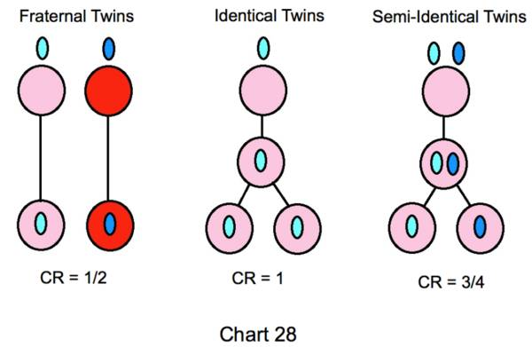
Part Three: Types of Twins

Slide 21
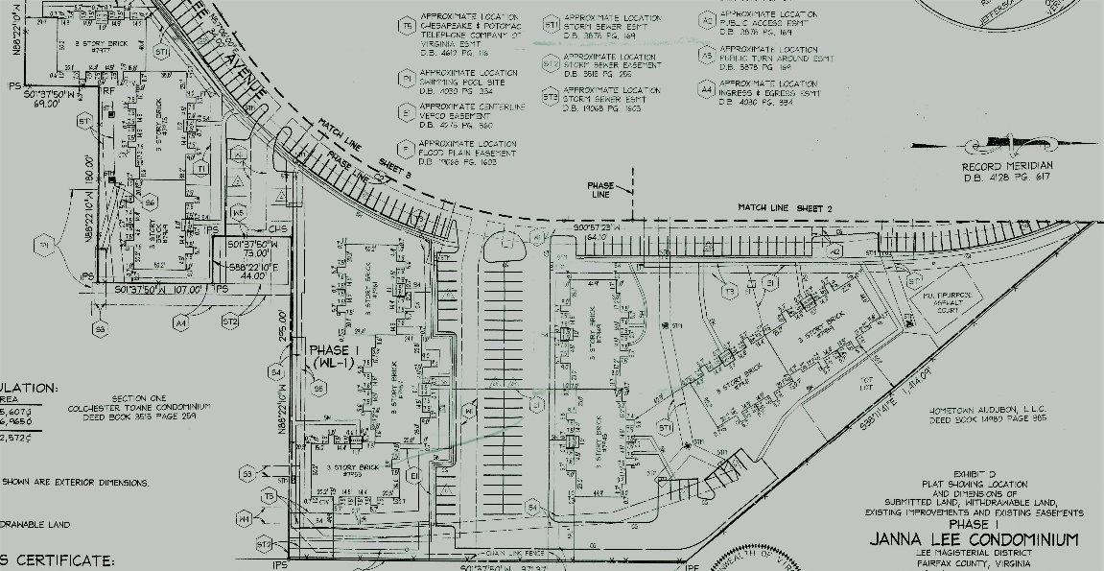
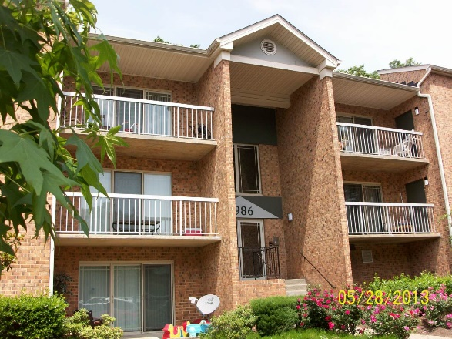
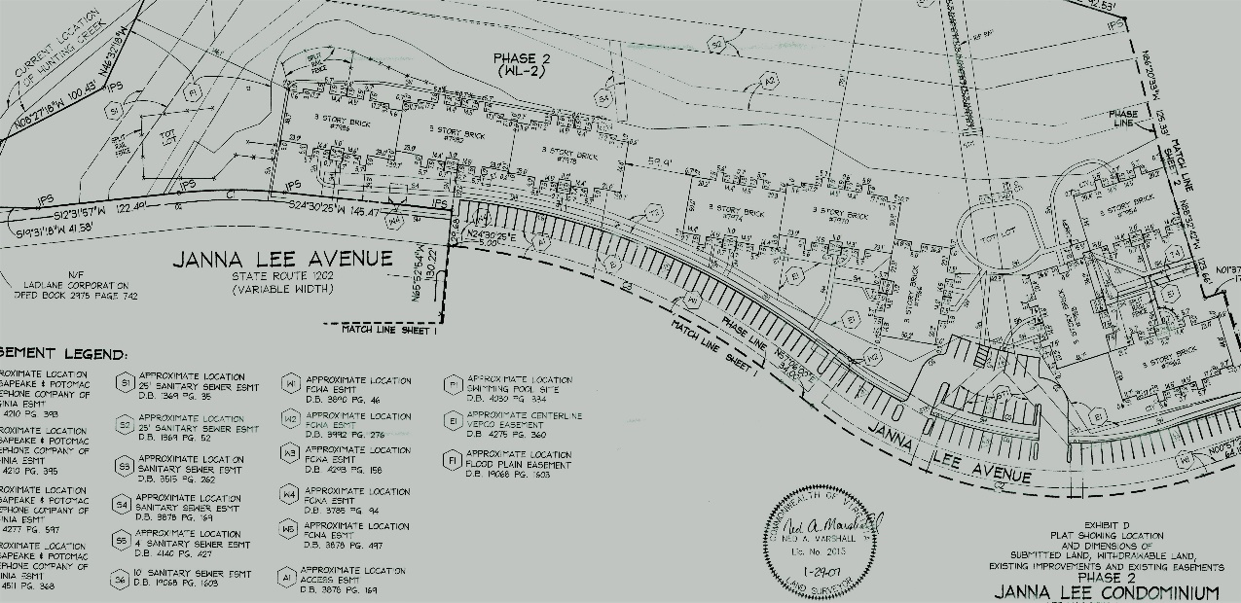
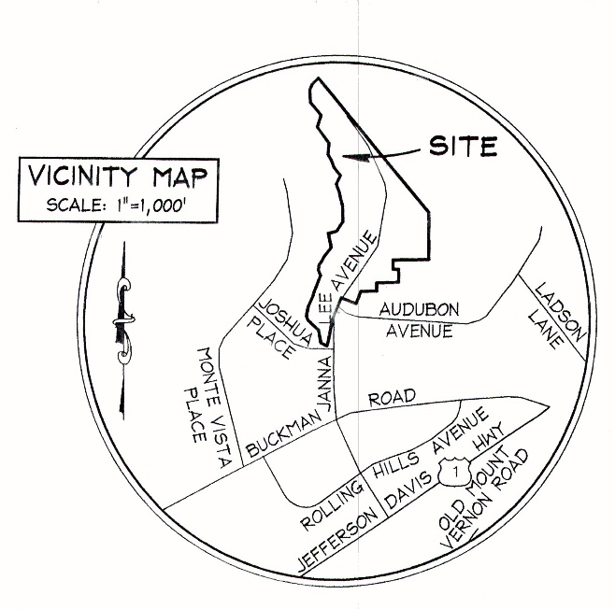
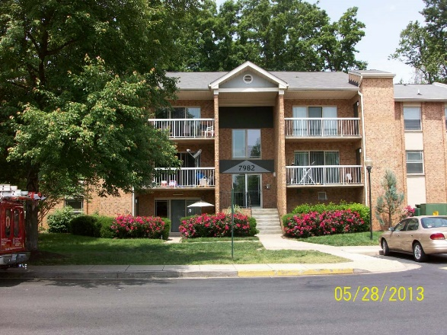
FraterNaL TWINS: Creekside I & II
Housing Capital Advisors, Rick Edson

Slide 22
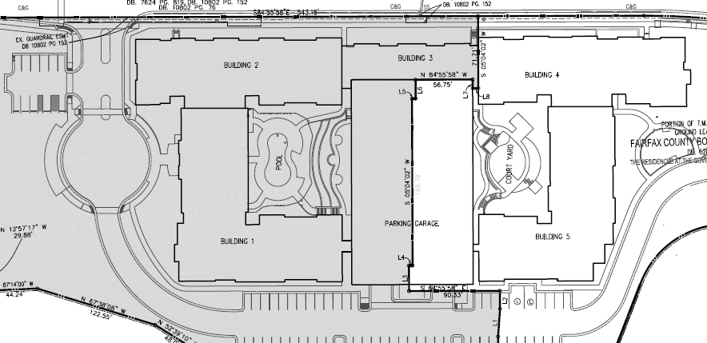
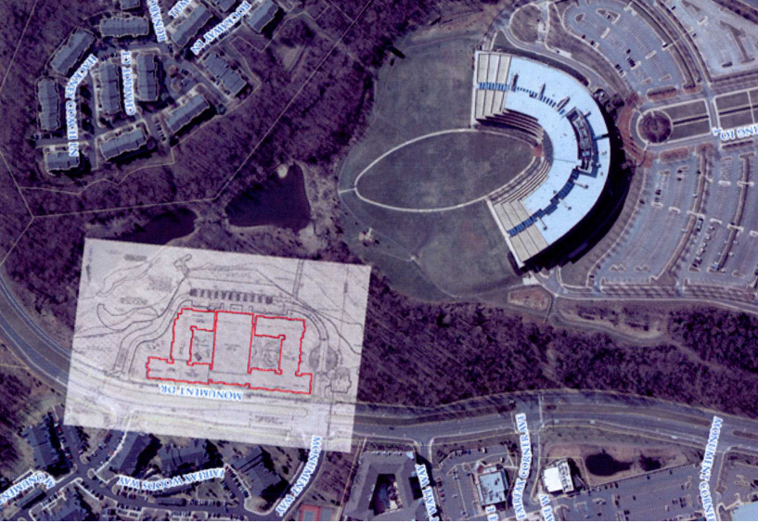

Conjoined Twins: Gov’t Residences A&B
JAG and Stratford Capital

Slide 23
GMOs (Checkerboarded): Alice Griffith 3
McCormack Baron Salazar

Slide 24
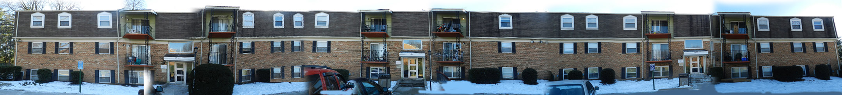
Identical Twins: Wexford Manor I & II
Wesley Housing Development Corp.

Slide 25


Part FOUR: Separating Wexford into the twins

Slide 26
Wexford: A Tale of Two Buildings
74-Unit, 2 Buildings (38 & 36 units) Garden style property, 3.8 acres
Important location in Fairfax County, Virginia
On-side Resident Services, Playground, Community Center, Parking, Laundry Facility
100% LIHTC: 50%@60% AMI, 40%@50% AMI, 10%@40% AMI
HAP for 14 Units; ID/DD; Services Committed
The Story of Wexford (soon to be repeated, nationwide) & Monetizing the Excess Basis

Slide 27
Twinning – Cost of Twinning
Wexford Manor Undivided as a single 9% Transaction
Permanent Sources
 | Sources | Per Unit
Tax Credit Equity | $6,071,206 | $82,043
First Mortgage | $7,290,000 | $98,514
Fairfax County Loan | $2,900,000 | $39,189
Seller Note | $1,729,725 | $23,375
TD Bank Grant | $100,000 | $1,351
Interim Income | $150,000 | $2,027
Deferred Fee | $908,305 | $12,274
Total Permanent | $19,149,236 | $258,773
Summarized Uses
 | Uses | Per Unit
Acquisition Costs | $7,687,712 | $103,888
Construction Costs | $6,836,830 | $92,390
Design, Engineering and Architecture | $546,946 | $7,391
Owner's Construction Costs, Professional Services and Fees | $240,020 | $3,244
Financing Costs | $950,370 | $12,843
Partnership Costs | $86,500 | $1,169
Developer's Costs, Carrying Costs and Reserves | $984,247 | $13,301
Developer's Fee | $1,816,610 | $24,549
Total Uses | $19,149,236 | $258,773
Excess (GAP) Permanent | $0

Slide 28
Twinning – Cost of Twinning
Wexford A (9%) – one of the twins
Permanent Sources
 | Sources | Per Unit
Tax Credit Equity | $4,826,702 | $127,018
First Mortgage | $3,600,000 | $94,737
Fairfax County Loan | $1,600,000 | $42,105
Seller Note | $1,842,567 | $48,489
TD Bank Grant | $51,351 | $1,351
Interim Income | $125,000 | $3,289
Deferred Fee | $416,650 | $10,964
Total Permanent | $12,462,270 | $327,954
Summarized Uses
 | Uses | Per Unit
Acquisition Costs | $4,857,943 | $127,841
Construction Costs | $4,538,777 | $119,442
Design, Engineering and Architecture | $528,722 | $13,914
Owner's Construction Costs, Professional Services and Fees | $190,102 | $5,003
Financing Costs | $861,545 | $22,672
Partnership Costs | $86,500 | $2,276
Developer's Costs, Carrying Costs and Reserves | $448,680 | $11,807
Developer's Fee | $950,000 | $25,000
Total Uses | $12,462,270 | $327,954

Slide 29
Twinning – Cost of Twinning
Wexford B (4%) – the other twin
Permanent Sources
 | Sources | Per Unit
Tax Credit Equity | $2,724,834 | $75,690
First Mortgage | $4,625,000 | $128,472
Fairfax County Loan | $1,300,000 | $36,111
Seller Note | $1,416,207 | $39,339
TD Bank Grant | $48,649 | $1,351
Interim Income | $100,000 | $2,778
Contribution from Building A | $126,304 | $3,508
Deferred Fee | $488,819 | $13,578
Total Permanent | $10,829,813 | $300,828
Summarized Uses
 | Uses | Per Unit
Acquisition Costs | $4,428,908 | $123,025
Construction Costs | $3,908,255 | $108,563
Design, Engineering and Architecture | $226,315 | $6,287
Owner's Construction Costs, Professional Services and Fees | $98,859 | $2,746
Financing Costs | $639,277 | $17,758
Partnership Costs | $86,500 | $2,403
Developer's Costs, Carrying Costs and Reserves | $441,699 | $12,269
Developer's Fee | $1,000,000 | $27,778
Total Uses | $10,829,813 | $300,828
Excess (GAP) Permanent | $0

Slide 30
Twinning – Cost of Twinning
Wexford Comparison
Permanent Sources | Original |  | A & B |  | Twin-Original
 | Sources |  | Sources |  | Delta
Tax Credit Equity | $6,071,206 |  | $7,551,537 |  | $1,480,331
First Mortgage | $7,290,000 |  | $8,225,000 |  | $935,000
Fairfax County Loan | $2,900,000 |  | $2,900,000 |  | $0
Seller Note | $1,729,725 |  | $3,258,774 |  | $1,529,049
TD Bank Grant | $100,000 |  | $100,000 |  | $0
Interim Income | $150,000 |  | $225,000 |  | $75,000
Contribution from Building A |  |  | $126,304 |  | $126,304
Deferred Fee | $908,305 |  | $905,469 |  | -$2,837
Total Permanent | $19,149,236 |  | $23,292,083 |  | $4,142,847
Summarized Uses
 | Uses
Acquisition Costs | $7,687,712 |  | $9,286,851 |  | $1,599,139
Construction Costs | $6,836,830 |  | $8,447,032 |  | $1,610,202
Design, Engineering and Architecture | $546,946 |  | $755,037 |  | $208,091
Owner's Construction Costs, Prof. Services and Fees | $240,020 |  | $288,962 |  | $48,942
Financing Costs | $950,370 |  | $1,500,822 |  | $550,451
Partnership Costs | $86,500 |  | $173,000 |  | $86,500
Developer's Costs, Carrying Costs and Reserves | $984,247 |  | $890,379 |  | -$93,868
Developer's Fee | $1,816,610 |  | $1,950,000 |  | $133,390
Total Uses | $19,149,236 |  | $23,292,083 |  | $4,142,846

Slide 31
Twinning and the Impact on the Investor/Lender
Underwriting as Lender
  Considering each deal separately, and as a whole
  Two Borrowers, one Guarantor
  Two Appraisals
  Two Plan and Cost reports
  Two ESA Reviews
  Two GC Contracts, one GC
  Two Budgets, one completed project
    Can they work as standalone
    What risks, since they can’t be crossed?
    Or can they?
  Separate income targeting, subsidies?
  Two sets of Loan Documents and Equity Documents
Underwriting as Investor
  Impact on Investor with different construction lenders

Slide 32
The Wexford Wonder Twins—Lessons Learned
Lender Approvals & The Automatic Do-over
  VHDA
  Fairfax County and The RHA
  HUD (HAP, and ID/DD Fair Housing Waivers)
Allocation Issues
  Community Center
  Costs and Bond Counsel
Improving the Deal—Parking
Shared Operating Costs
Related Party Sale Issues (revise structuring to still work)
Additional Tax Issues (capital accounts)

Slide 33
Lessons Learned (or not!)
Application Stage: “Every QAP Competition is Won Before it is Submitted”
The A Team—people who know the players and programs
Application Issues—First, lots of Peyote!
Allocation Issues
Design Issues
Site Control & the Seller
Post Application: You are a Winner! (of tax credits)…What’s Next?
Working with your Contractor
Zoning and Permitting
Assembling the Pieces of the Financing Puzzle
Closing Time: The Bantaan March
Closing Logistics
Accelerated Credit Delivery, Condos

Slide 34

Questions?
Edmund K. Delany
Senior Vice President
Capital One Community Finance
8000 Towers Crescent Drive
7th Floor
Vienna, VA 22182
571-835-7140 (direct)
Edmund.delany@capitalone.com
Deborah L. Norris, CPA
Hertzbach & Company, P.A.
410.363.3200 | 443.471.2052
dnorris@hertzbach.com
www.hertzbach.com
Baltimore | Greater Washington, D.C. | N. Virginia
Erik T. Hoffman
Klein Hornig LLP
1325 G Street NW, Washington, DC 20005
202-842-0125 (direct)
ehoffman@kleinhornig.com
www.kleinhornig.com

