Slide 1
The Washington DC Housing Market: Trends and Outlook
Housing Association of Non-Profit Developers
December 11, 2014
Lisa A. Sturtevant, PhD
Vice President of Research, NHC

Slide 2
CURRENT HOUSING MARKET:
5 CHARACTERISTICS OF THE REGION’S RECOVERY

Slide 3
Key Characteristics – Washington DC Housing Market
Slower Job Growth
Rising Prices and Rents
Expanding For-Sale Inventory
Convergence of Market Activity Across the Region
Increase in New Construction

Slide 4
1. Job Growth Has Slowed
(000s)
Annual Job Change – MOTY
Washington MSA
Source: Bureau of Labor Statistics (Not Seasonally Adjusted), GMU Center for Regional Analysis

Slide 5
Other Regions Gaining Jobs Faster
(000s)
Job Change Oct 2013 – Oct 2014
15 Largest Job Markets
Washington +17,600
Source: Bureau of Labor Statistics (Not Seasonally Adjusted), GMU Center for Regional Analysis

Slide 6
Growth Uneven Across the Economy
Job Change by Sector Oct 2013 – Oct 2014 Washington MSA
(000s)
Total = 17,600
Source: Bureau of Labor Statistics (Not Seasonally Adjusted), GMU Center for Regional Analysis

Slide 7
2. Price Increases Have Slowed
Average Sales Price Percent Change Washington MSA All Housing Types
Annual Change Annual Change by Month
2010 2011 2012 2013 2014
%
Source: Metropolitan Regional Information Systems (MRIS), GMU Center for Regional Analysis

Slide 8
Average Sales Price Percent Change Washington MSA Single-Family Detached
Annual Change Annual Change by Month
2010 2011 2012 2013 2014
%
Source: Metropolitan Regional Information Systems (MRIS), GMU Center for Regional Analysis

Slide 9
Average Sales Price Percent Change Washington MSA Single-Family Attached
Annual Change Annual Change by Month
2010 2011 2012 2013 2014
%
Source: Metropolitan Regional Information Systems (MRIS), GMU Center for Regional Analysis

Slide 10
Average Sales Price Percent Change Washington MSA Condominiums
Annual Change Annual Change by Month
2010 2011 2012 2013 2014
%
Source: Metropolitan Regional Information Systems (MRIS), GMU Center for Regional Analysis

Slide 11
But Rents Continue to Rise
Median Rent Washington MSA
Source: U.S. Census Bureau, 2000 Census SF3; American Community Survey 1-year estimates

Slide 12
3. Inventories Have Been Growing
Percent Change in Inventories of Existing Homes Month-Over-Year
Washington MSA
%
Oct =
+21.7%
Source: Metropolitan Regional Information Systems (MRIS), GMU Center for Regional Analysis. Total monthly inventory includes listings active at the end of the month plus sales during the month.
Notes:
Source: RBI excel sheets (current data)

Slide 13
Total Listings Per Sale Oct Each Year
Source: Metropolitan Regional Information Systems (MRIS), GMU Center for Regional Analysis

Slide 14
Rental Vacancy Rates Have Edged Up
Rental Vacancy Rate Washington MSA
Source: U.S. Census Bureau, SF3; American Community Survey 1-year estimates

Slide 15
4. Recovery Has Become Widespread
Median Sales Price by Jurisdiction
Washington MSA

Slide 16
Average Sales Price Percent Change District of Columbia
Annual Change Annual Change by Month
2010 2011 2012 2013 2014
%
Source: Metropolitan Regional Information Systems (MRIS), GMU Center for Regional Analysis

Slide 17
Average Sales Price Percent Change Suburban Maryland
Annual Change Annual Change by Month
2010 2011 2012 2013 2014
%
Source: Metropolitan Regional Information Systems (MRIS), GMU Center for Regional Analysis

Slide 18
Average Sales Price Percent Change Northern Virginia
Annual Change Annual Change by Month
2010 2011 2012 2013 2014
%
Source: Metropolitan Regional Information Systems (MRIS), GMU Center for Regional Analysis

Slide 19
5. Construction Activity Up Steadily
Building Permits
Washington MSA
2001 – 2014, 3-Month Mvg Avg
Source: Census Bureau, GMU Center for Regional Analysis
Notes:
Source: http://www.census.gov/construction/bps/msamonthly.html

Slide 20
Building Permits by Type Washington MSA
Source: Census Bureau

Slide 21
OUTLOOK FOR THE REGION’S HOUSING MARKET:
5 ECONOMIC & DEMOGRAPHIC TRENDS

Slide 22
Key Trends – Outlook for the Washington DC Housing Market
Economic Restructuring
Rising Affordability Challenges
Aging of the Population
Demand from Millennials
Growth of Minority Population

Slide 23
1. Changing Structure of the Economy
Slower growth in Federal Government and Professional & Business Service jobs
Faster growth in Leisure & Hospitality, Retail and Construction jobs
Source: Bureau of Labor Statistics (Not Seasonally Adjusted), GMU Center for Regional Analysis

Slide 24
Change in Federal Government Jobs Washington MSA
(000s)
Annual Data Annual Month over Year
2009 2010 2011 2012 2013 2014
Source: Bureau of Labor Statistics (Not Seasonally Adjusted), GMU Center for Regional Analysis

Slide 25
Change in Professional & Business Services Jobs Washington MSA
(000s)
Annual Data Annual Month over Year
2009 2010 2011 2012 2013 2014
Source: Bureau of Labor Statistics (Not Seasonally Adjusted), GMU Center for Regional Analysis

Slide 26
Washington Metropolitan Area Job Change
by Wage Category between 2008 to 2013
Sources: EMSI 2013.3 & GMU Center for Regional Analysis

Slide 27
Principal Sources of Job
Growth in the Washington Area, 2012-2032
(000s)
Job % of Total Median
Change Job Change Wage*
Prof. & Sci. Svcs/Mgt 401.8 46.9% $81,500
Admin & Waste Svcs 139.0 16.2 29,500
Construction 95.0 11.1 36,700
Health Services 71.2 8.3 39,500
Leisure/Hospitality 45.9 5.4 18,300
Sub-Total 753.1 87.8%
Overall Total 857.3 100.0 $48,900
* in 2011$s
Source: 2009-2011 ACS, IHS Global Insight, MWCOG, BLS, GMU Center for Regional Analysis.

Slide 28
2. Housing Affordability is a Challenge
Housing Opportunity Index
Washington MSA
Source: Core Logic, HUD & Federal Housing Finance Agency

Slide 29
Thousands of Households Cost Burdened
Households Spending More than Half of Their Income on Housing
190,000 working households
Source: NHC Center for Housing Policy, Housing Landscape 2014

Slide 30
Cost Burden Varies Around the Region
Jurisdiction | % of renters spending half or more of their income housing
Arlington County | 19
City of Alexandria | 20
District of Columbia | 26
Fairfax County and the Cities of Fairfax and Falls Church | 18
Montgomery County | 25
Source: U.S. Census Bureau, American Community Survey 1-Year file

Slide 31
Many Workers Can’t Afford to Buy a Typical Home
Source: NHC Center for Housing Policy, Paycheck to Paycheck

Slide 32
Or to Rent a Typical Apartment
Source: NHC Center for Housing Policy, Housing Landscape 2014

Slide 33
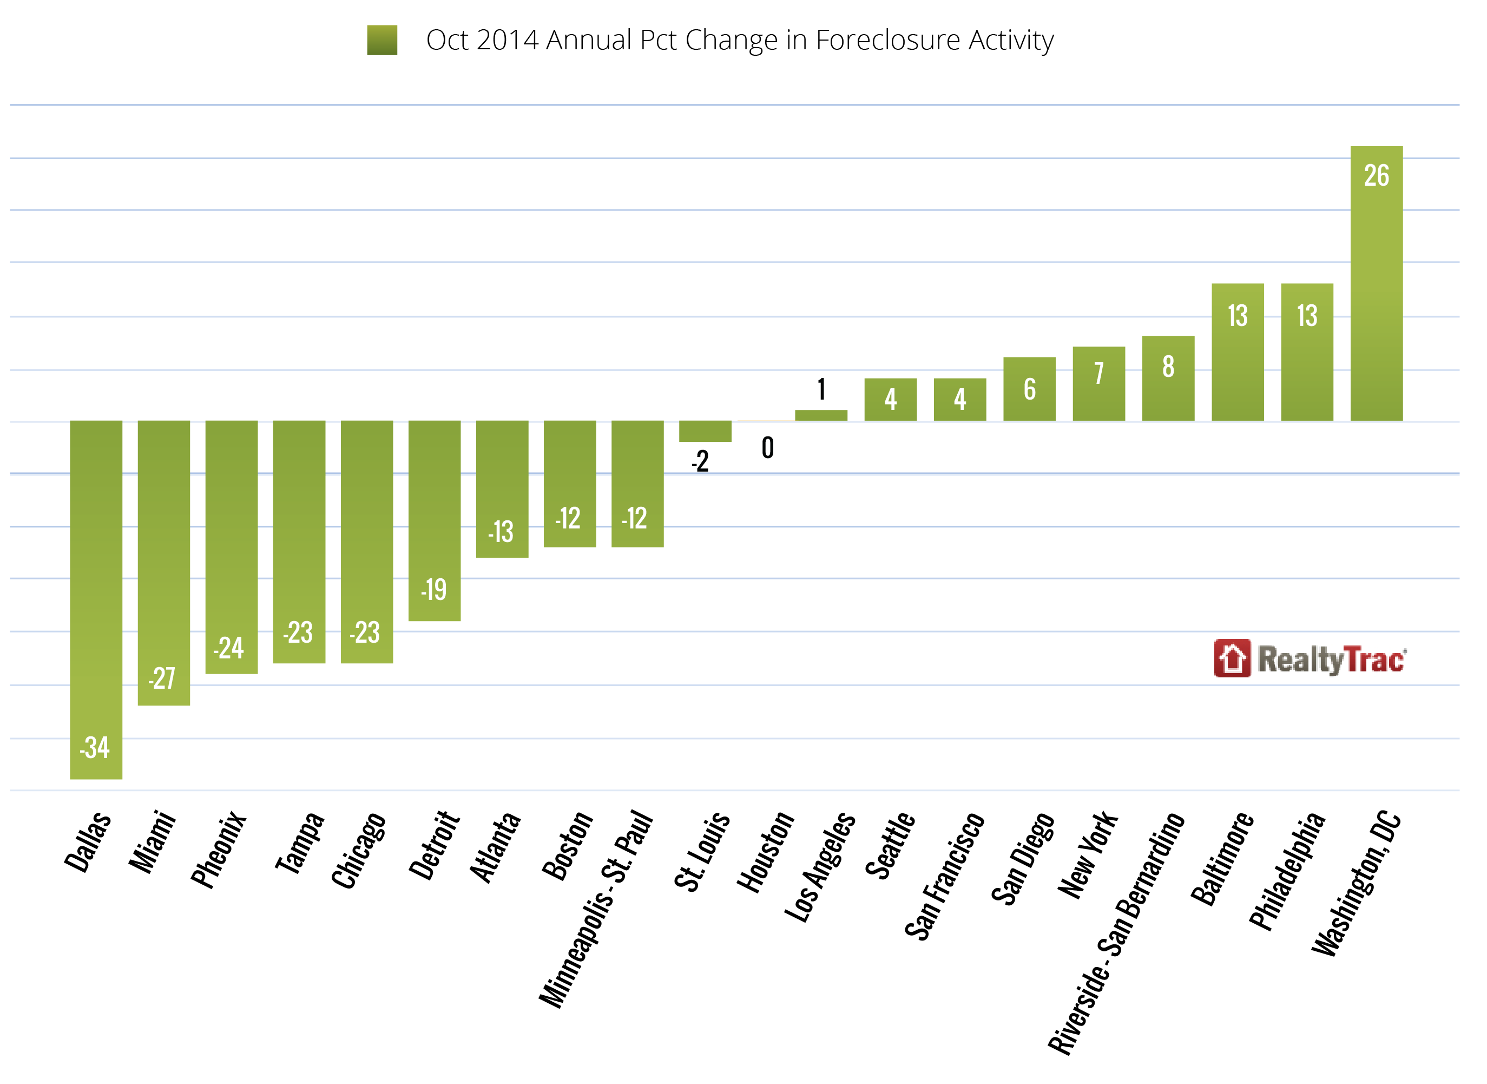
Foreclosure is a Growing Issue

Slide 34
3. More Seniors in the Population
Source: Census Bureau, Population Projections

Slide 35
Many Households Have Lost Wealth
-
-
Source: Pew Research Center, tabulations of Survey of Consumer Finances data

Slide 36
4. Millennials Drove Growth – In Some Places
Source: U.S. Census Bureau, 2000 Census SF3 and American Community Survey 1-year file

Slide 37
Millennials Less Likely to be Homeowners
Source: Census Bureau, American Community Survey 1-Year file

Slide 38
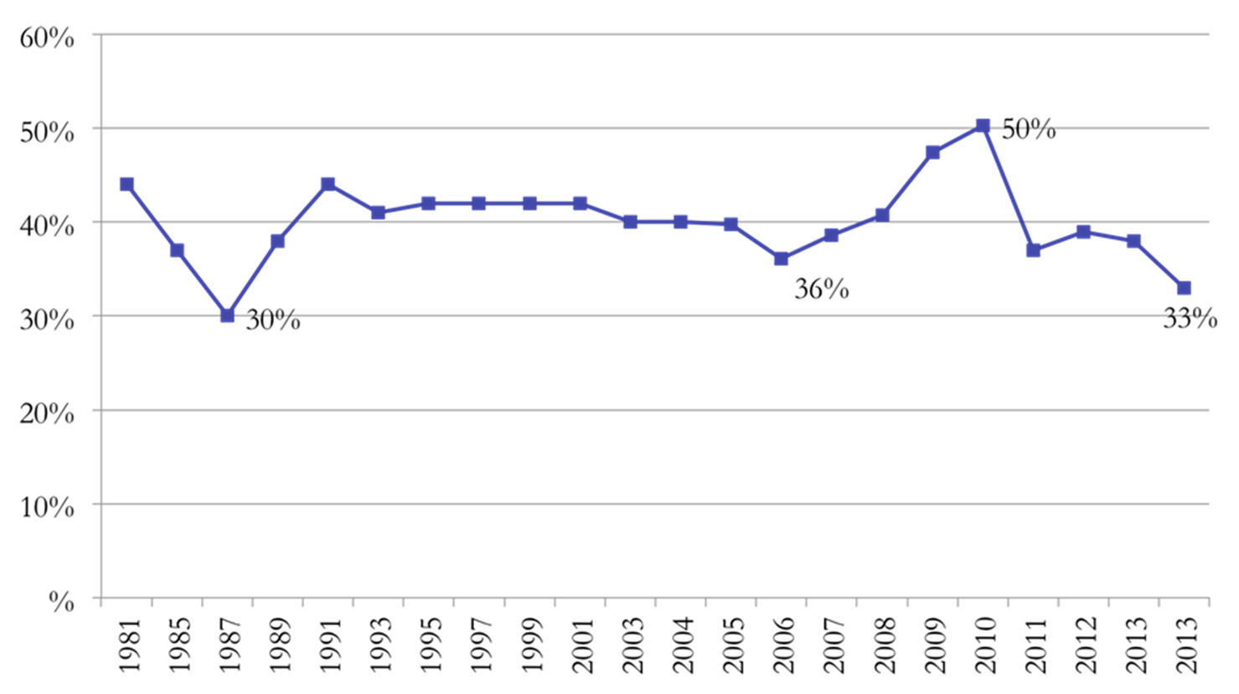
Many Have Been Sidelined
Share of Sales to First-Time Homebuyers - US
Source: National Association of Realtors®

Slide 39
5. Younger Population More Racially Diverse
Source: U.S. Census Bureau, American Community Survey 1-Year File

Slide 40
Faster Growth of Minority Population in the Suburbs
Percent Population Change, 2000 - 2012
Source: Census Bureau, American Community Survey 1-Year File

Slide 41
Minority Households Tend to Have Lower Incomes
Source: Census Bureau, American Community Survey 1-Year file

Slide 42
Key Takeaways from the Demographic and Economic Trends
Demographic and economic trends point to growing needs for affordable housing
Smaller homes, multi-family housing, rental housing
Close to jobs, transit, amenities
Different parts of the population competing for the same types of housing
Millennials, seniors, families
Needs vary around the region
Local responses to affordable housing needs
Needs vary considerably even within jurisdictions

Slide 43
Contact
Lisa Sturtevant
Center for Housing Policy and
National Housing Conference
lsturtevant@nhc.org
202-466-2121 x234
www.nhc.org
www.housingpolicy.org
www.foreclosure-response.org

